Slide 1
Ebm Seminar
Brian locke, MD
Based on seminars by Emily signor and Harris Carmichael.
Notes:
Notes for handoff: schedule in HSEB, show interns the guardsman shuttle (=quickest way back and forth from the VA)

Slide 2
Evidence- Based Medicine
Notes:
In 1991, Gordon Guyatt introduced the term evidence-based medicine (EBM) to showcase the importance of not only physician expertise but also current research evidence and patient values in clinical decision-making.

Slide 3
How to use the medical literature to make better clinical decisions.

Slide 4
Learning objectives
Understand how and why EBM is useful to you as a trainee
Practice a structured approach to answering clinical questions
Understand Primary vs Secondary/Tertiary medical literature
Understand validity, and identify common threats to validity (Bias, Confounding, Chance)
Understand (in a non-mathy way) how Bayes Theorem can be applied to diagnosis
Understand relevant metrics to assess treatment effects.
Be able to access several useful secondary literature sources quickly, at the point of care.
@UtahIMCMRs
#EBM

Slide 5
Learning objectives
Understand how and why EBM is useful to you as a trainee
Practice a structured approach to answering clinical questions
Understand Primary vs Secondary/Tertiary medical literature
Understand validity, and identify common threats to validity (Bias, Confounding, Chance)
Understand (in a non-mathy way) how Bayes Theorem can be applied to diagnosis
Understand relevant metrics to assess treatment effects.
Be able to access several useful secondary literature sources quickly, at the point of care.
@UtahIMCMRs
#EBM

Slide 6
Frameshift: Why do we give statins?
@UtahIMCMRs
Notes:
We learn mechanistic explanations for why we do things (e.g., this should work based on our understanding of physiology) – this line of thinking is termed causal inductive reasoning - supposing that something works from an understanding of the physiology – and is fraught.. Long history of medical reversals from this line of thinking – it just doesn’t work. Physiology is too complex.
Food for thought: as we are never exactly sure if our mechanistic understanding reflects reality (after all, they are inferences researchers have come up with to explain data), mechanisms have two roles: heuristics for remembering facts (that have demonstrated empirically) and generating research hypothesis (not usually applied to us)
What really matters at the bedside is whether or not something does work (not why) – and we should focus our learning efforts on assessing evidence of this
“evidence based medicine requires new skills of a physician.. The application of formal rules of e

Slide 7
Frameshift: Why do we give statins?
DOI: 10.1056/NEJMoa0807646
Notes:
For example, we learn that statins lower LDL via HMG-CoA reductase and it’s effect on the LDL receptor.
Yet, to demonstrate that we need to use the drug (and what situations to use it in) – what we really need to understand is how to interpret the evidence that it works, and the limitations of that evidence.
For example with statins: we use them because when we give it to people, they die less. (as demonstrated by the Jupiter trial – and notably the Jupiter trial showed that even in patient with normal LDL (<130) and no prior CVD, but elevated risk of ASCVD (hsCRP > 2), Rosuvastatin reduced mortality. This was not expected based on mechanistic thinking)
(think metformin – nobody really knows how it works, but we’re very sure that it does.)
This is not taught nearly as much during medical school
Reason number 1 why EBM is important: It is the ACTUAL reason why we practice the way we do.
Note: this philosophy is called instrumentalism: https://en.wikipedia.org/wiki/Instrumentalism

Slide 8
EBCP in action
A 42 year old woman with obesity and 1 month of transient postprandial RUQ pain presents with fever, malaise, and unremitting RUQ pain.
Notes:
Patient presents with fever and RUQ pain. What next?
Reflect:
How are you coming up with a differential diagnosis? It doesn’t feel like ‘evidence based medicine’. No statistics

Slide 9
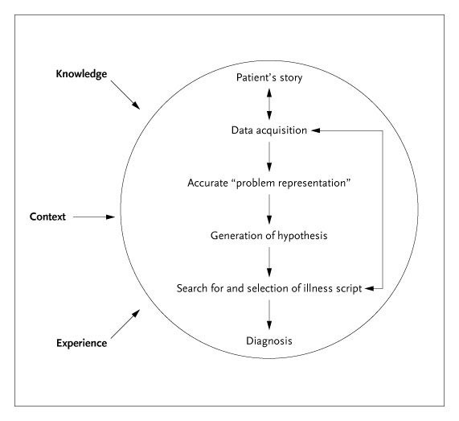
Clinical Reasoning?
Problem Representation:
Patient (demographics, risk-factors)
Timeframe
Clinical Syndrome
Illness Script
Mental summary of prototypical characteristics of a disease presentation
Bowen JL. N Engl J Med 2006;355:2217-2225.
Notes:
What we actually do is use heuristics, matching problem representations (abstractions of the pertinent information about a presentation – patient, timeframe, and clinical syndrome) to illness scripts (our ideas of the prototypal presentation of different illnesses).
No math or statistics here – just pattern recognition and matching. (This is called Recognition Primed Decision-Making)
In our example: problem representation = middle aged obese woman with RUQ and fever
Cholecystitis script: acute RUQ pain with fever that occurs in obese middle aged women. Associated with leukocytosis and cholestatic liver chemistry elevation. +Murphy’s sign, GB wall thickening on US
----Semi-related-----
Diagnostic Schema – cognitive tool to help match problem representations to illness scripts by identifying key features that help discriminate possibilities. E>g. pre-renal, intrinsic, post-renal AKI

Slide 10
What about Intuition?
A bat and a ball together cost 1.10$
The bat costs 1$ more than the ball.
How much does the ball cost?
Notes:
Ask this question – what did you gut say the answer is? Are you sure?
(this is called a cognitive reflection test)

Slide 11
What about Intuition?
A bat and a ball together cost 1.10$
The bat costs 1$ more than the ball.
How much does the ball cost?
System 1 (intuition): 10c
System 2 (deliberation): 5c
Notes:
Ask this question – what did you gut say the answer is? Are you sure?
Dual Process Theory:
System 1: fast, intuitive, emotional. Influenced by biases (recency, availability)
System 2: slow, deliberative, logical. Too cumbersome to be used on the fly (we make WAY too many decisions)

Slide 12
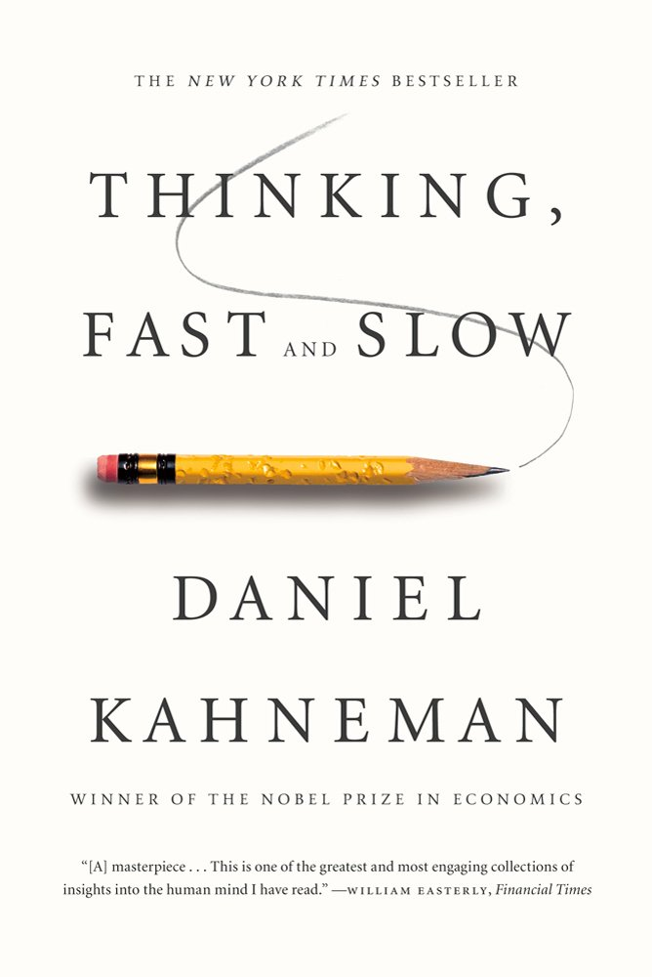
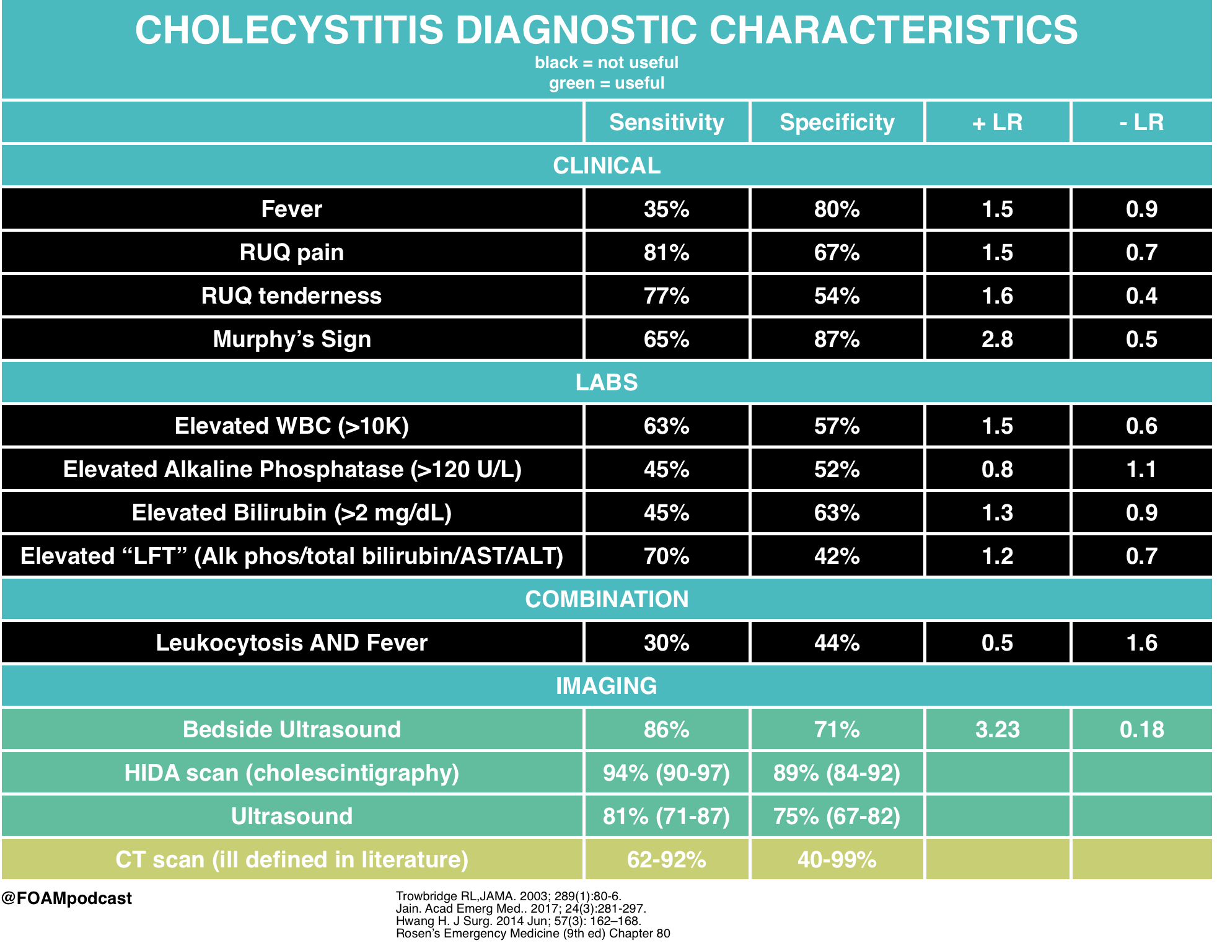
What about Intuition?
Notes:
In clinical medicine.
We almost operate in system 1 (due to speed and ease), but system 2 can inform our intuitions (after all, you have to learn the illness scripts) – and this is how research is done.
Reason #2 – it can make you better at clinical reasoning

Slide 13
EBCP in action
A 42 year old woman with episodic headache, palpitations, and sweating. She comes in after one such episode. BP 180/70.
Notes:
Reflect:
How are you coming up with a differential diagnosis?

Slide 14
What about Intuition?
Pheochromocytoma
0.8 per 100,000 person years
Cocaine/Meth use
Panic attacks
Hyperthyroidism
Etc.
VS
Notes:
HOWEVER, what about cases that don’t easily fit? “Uncommon presentations of common diseases are more likely than uncommon presentations”
For example: how many of you have seen presentations of: Young patient with episodic palpitations, sweating, and headache? IT’S (almost) NEVER A PHEO
Recognition Primed Decision-Making does not account for pre-test probability (meaning, you select the illness script that matches the best – or the first one that you think of that matches well enough)
It’s hard to reason about rare events, and unlike on test questions, the pre-test probability is crucial.
Bayes’ theorem helps overcome many well-known cognitive errors in diagnosis, such as ignoring the base rate, probability adjustment errors (conservatism, anchoring and adjustment) and order effects

Slide 15
Bias in clinical reasoning?
Name of Bias | Description
Availability | Considering easily remembered diagnoses more likely irrespective of prevalence
Base rate neglect | Pursuing “zebras”
Representativeness | Ignoring atypical features that are inconsistent with the favored diagnosis
Confirmation bias | Seeking data to confirm, rather than refute the initial hypothesis
Premature closure | Stopping the diagnostic process too soon
Notes:
Type 1 (Heuristic-based) reasoning is prone to many biases: important ones include the (many) listed in the above table. It’s interesting to think of how these influence your reasoning (e.g. availability bias, multiple alternatives bias)
(Don’t go through all – just choose an interesting 1 or 2 to demonstrate the point)
Diagnostic errors account for more than 8% of adverse events in medicine and up to 30% of malpractice claims. Mechanisms of errors may be related to the working environment but cognitive issues are involved in about 75% of the cases, either alone or in association with system failures.
doi: 10.4414/smw.2012.13706. (source of above quote and graph)
Reason 3: we are prone to errors that come from trusting our gut. Type 2 reasoning can help overcome this.
https://catalogofbias.org/
Note: there is significant debate on the real world impact of biases: there is not much interoperator agreement in labeling biases, their invocation is very dependent on hindsight (e.g. premature closure is only premature if you get the dx wrong), and strategies of “debiasing” have been shown not to work.
Dhaliwal G. BMJ Qual Saf 2017;26:87–89. doi:10.1136/bmjqs-2016-005267

Slide 16
What about Intuition?
NNH 94 for adverse kidney event
Being wrong and being right feel exactly the same
Notes:
Josh Billings - humorist “the trouble with a great many of us is we know so many things that ain’t so.“
David casarett - therapeutic illusion in NEJM - https://www.nejm.org/doi/full/10.1056/NEJMp1516803- “Physicians overestimate the benefit of what they themselves do “
Consider one last example:
Another shortfall of heuristics is inability to detect subtle clinical effects. SMART trial showed an effect that was imperceptibly small- yet extremely important to the outcomes of our patients.
Details of the study: Major adverse kidney event in 30 days (MAKE-30): A composite of death from any cause, new renal-replacement therapy, or persistent renal dysfunction (elevation in sCr to ≥ 200% of baseline). These were determined at 30 days or hospital discharge, whichever occurred first. Statistically significant improvement in this primary endpoint, NNH 94
We don’t often get feedback on whether we do the right thing: in cases where effect sizes are small or feedback is not rapid: “being wrong and being right feel exactly the same”. I resuscitated patients in the ICU as an intern – probably enough to have caused one of these events. But I certainly didn’t notice.
The majority of the things do not have large, obvious positive effects (e.g. do we need a trial to show that parachutes are beneficial?). Counter: how common are large treatment effects? 5x RR or greater => 9% of trials, and usually for a lab surrogate, not a patient centered outcome. 90% of those had smaller effects when retested = 1% of trials show a truly large effect size. only ecmo for newborns had a large effect on mortality . Ionnadis 2012
(note, it seems that this could also argue we are doing a good job of only running trails with clinical equipoise)
Reason 4: It’s the way we can actually figure out if we’re doing the right thing, and harming vs helping patients.
More patients died of anti-arrhythmic (e.g. Lidocaine) to suppress rhythms after MI before the CAST trial showed it was harmful than soldiers died in Vietnam (https://www.amazon.com/Deadly-Medicine-Thousands-Patients-Americas/dp/0684804174)
IN SUMMARY:
At least 2 uses of system 2 thinking:
-diagnostic process starts with system 1 thinking, and invoke system 2 when it starts failing. Intuition is wrong and strong .. "if it feels true it is". Certainty just means that we have a cohesive story... not that the story is true.
-system 2 thinking is how you properly calibrate system 1 (intuition) – none of us are born with a sense for what cholecystitis presents like.

Slide 17
What is EBCP?
Notes:
Evidence-based clinical practice (EBM informed practice)
The process of systematically finding, appraising, and using contemporaneous research findings as the basis for clinical decisions. Evidence-based medicine (EBM) follows four steps: formulate a clear clinical questions from a patient's problem; search the literature for relevant clinical articles; evaluate (critically appraise) the evidence for its validity and usefulness; implement useful findings in clinical practice. Rosenberg W, Donald A. Evidence based medicine: An approach to clinical problem-solving. BMJ. 1995;310:1122-1126
Note: if you want to get really deep in to it… EBM is an epistemological system (philosophical study of nature of knowledge / claims around what Is known) – since it presupposed a certain relationship between theory, evidence, and knowledge.. but probably more useful to think of it as a heuristic structure to optimize clinical practice.
Epistemologic Principles of Evidence-Based Medicine￼
1. The pursuit of truth is best accomplished by examining the totality of evidence, rather than by selecting a limited sample of evidence, which is at risk of being unrepresentative and will certainly be less precise than the totality.
2. Not all evidence is equal, and a set of principles can identify more vs less trustworthy evidence.
3. Evidence is necessary but not sufficient. Clinical decision making requires the application of values and preferences.

Slide 18
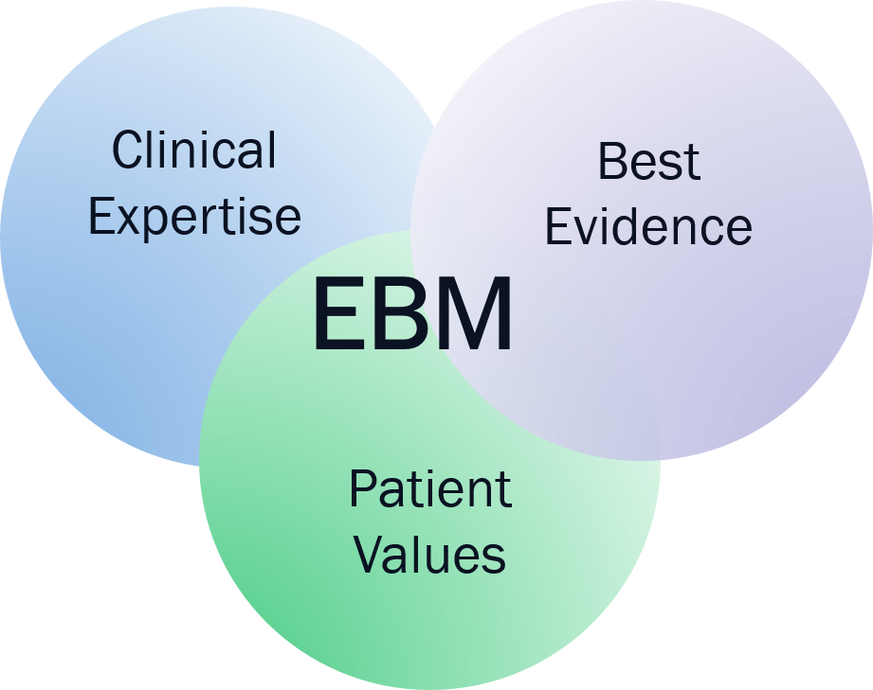
EBM / EBCP – Asking clinical questions
4 A’s
Ask
Acquire
Assess
Apply
Source: Rosenberg W, Donald A. Evidence based medicine: An approach to clinical problem-solving. BMJ. 1995;310:1122-1126
Notes:
Note; markedly PRIMARY literature focused – we will discuss modifications to this later. However, still useful to look at the granular framework as a start
Here’s a framework for analyzing how to do this
Step 1: Assess your patient and determine the pertinent issues. You may be looking for evidence about therapy options, prognosis or diagnostic techniques.
-----
Step 2: Ask a clinical question. Use the PICO model to formulate a clear and concise clinical question.
Step 3: Acquire the best evidence. Search the appropriate databases and resources to find the best evidence.
Step 4: Appraise the evidence. Determine whether the information you found is relevant, valid and applicable to your patient.
Step 5: Apply the evidence to your patient. Ensure that the evidence and recommendations meet your patient's values and expectations.

Slide 19
Learning objectives
Understand how and why EBM is useful to you as a trainee
Practice a structured approach to answering clinical questions
Understand Primary vs Secondary/Tertiary medical literature
Understand validity, and identify common threats to validity (Bias, Confounding, Chance)
Understand (in a non-mathy way) how Bayes Theorem can be applied to diagnosis
Understand relevant metrics to assess treatment effects.
Be able to access several useful secondary literature sources quickly, at the point of care.
@UtahIMCMRs
#EBM

Slide 20
ASK

Slide 21
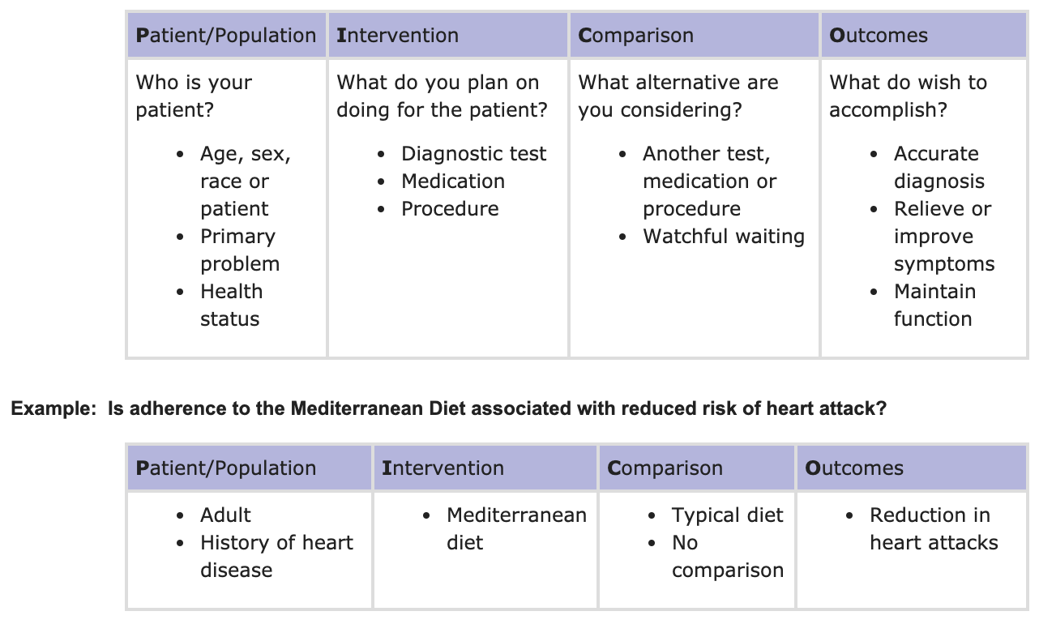
ASK – How do I ask a clinical question?
http://mcw.libguides.com/EBM/PICO
@UtahIMCMRs
#EBM
Notes:
Important to be specific: considering the specifics of your questions in order to make it “answerable. In the traditional model, this helps to identify the correct primary literature source

Slide 22
ASK – categories of (Foreground) questions?
Differential Diagnosis
Diagnosis (PEO – Patient, exposure/test, outcome/gold std.)
Prognosis (PEO – Patient, exposure/time, outcome)
Therapy (PICO- Patient, Intervention, Comparison, Outcome)
Harm
@UtahIMCMRs
#EBM
Notes:
The type of question you ask influences the type of study needed to answer the question. (NOTE: these are all “foreground” questions – we will return to this later)
Note: PICO is the method for determining response to an intervention (I in PICO) = THERAPY
Outcome: patients, exposure (time), and outcome. An alternative focuses on patient-related factors, such as age and sex, that can modify prognosis: patients, exposure (eg, older age or male), comparison (eg, younger age or female), and outcome.
For tests (e.g. Diagnosis) - For diagnostic tests, the structure we suggest is patients, exposure (test), and outcome ( vs criterion standard).

Slide 23
EBCP in action
A 60 YOM without prior OA presents with concerns of his chronic right knee pain. He states he was recently seen by an orthopedic surgeon. They obtained an MRI that showed a degenerative meniscal tear. The surgeon informed your patient he could improve the patient’s knee pain with a simple arthroscopic procedure. The patient you asks if you would place a referral for the procedure?
Notes:
PICO Format:
Patient: 65+, M, Bilateral OA (we don’t know traumatic, degenerative, etc.)
Intervention: arthroscopy
Comparison: intervention vs nothing (ideally, sham surgery if we want to see if the surgery works)
Outcome: improvement in pain (you could also investigate locking, mechanical symptoms)
Therapy question. Need RCT to definitively answer

Slide 24
ACQUIRE
Notes:
Consider adding a slide with the diagram here:
add content here: https://www.cebm.net/2014/04/study-designs/

Slide 25
ASK – Target your search based on question type
Differential Diagnosis
Diagnosis
Prognosis
Therapy (=>RCT)
Harm
Source: https://guides.dml.georgetown.edu/ebm
@UtahIMCMRs
#EBM
Notes:
The type of question you ask influences the type of study needed to answer the question

Slide 26
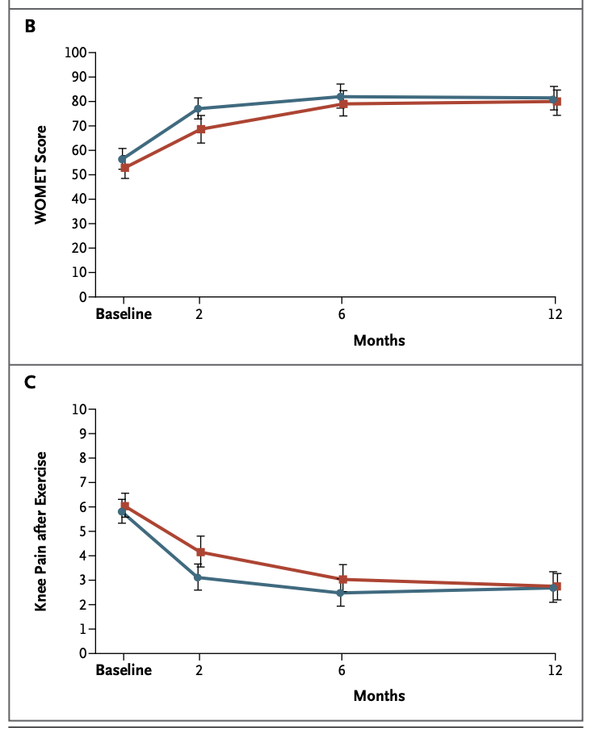
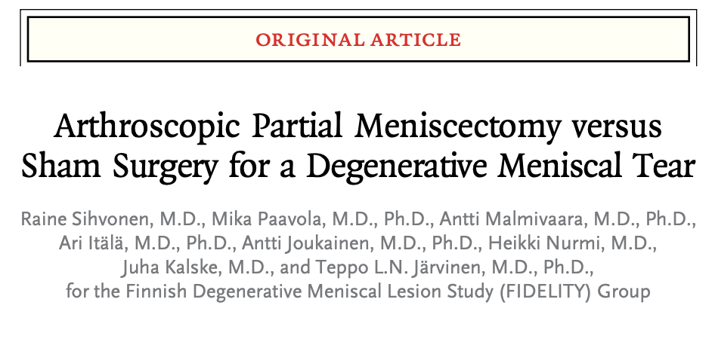
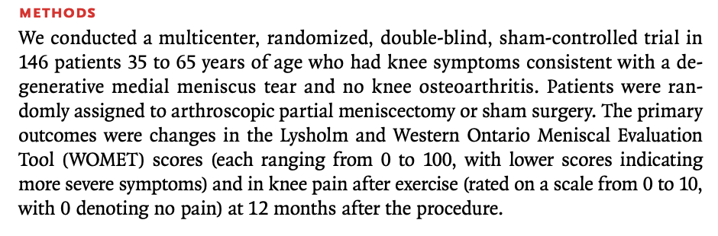
Meniscal tear
Notes:
Therapy: need an RCT (ideally)
Patient: meets inclusion criteria
Intervention: meniscectomy
Comparison: Sham surgery is best – prior RCTs with a no surgery comparison indicated an effect… whereas this study with a better control did not.
Outcome: pain and WOMET

Slide 27
EBCP in action
A 60 YOM without prior OA presents with concerns of his chronic right knee pain. He states he was recently seen by an orthopedic surgeon. They obtained an MRI that showed a degenerative meniscal tear. He asks you what the recovery would be like if he has surgery?
Notes:
Lets change the patient’s question.
PICO:
Patient: 65+, M, Bilateral OA (we don’t know traumatic, degenerative, etc.)
Intervention: arthroscopy
Comparison: no comparison
Outcome: functional status

Slide 28
ASK – What are some categories of questions?
Differential Diagnosis
Diagnosis
Prognosis (=>Cohort)
Therapy
Harm
Source: https://guides.dml.georgetown.edu/ebm
@UtahIMCMRs
#EBM
Notes:
The type of question you ask influences the type of study needed to answer the question
In this example: this is a prognosis question – cohort study gives us the information we need (an RCT also gives us this information)

Slide 29
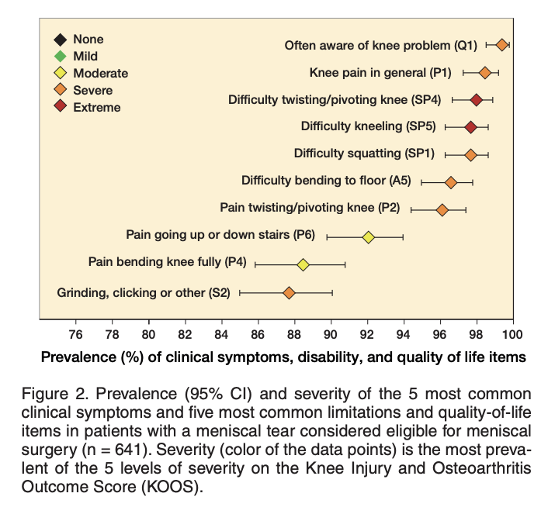
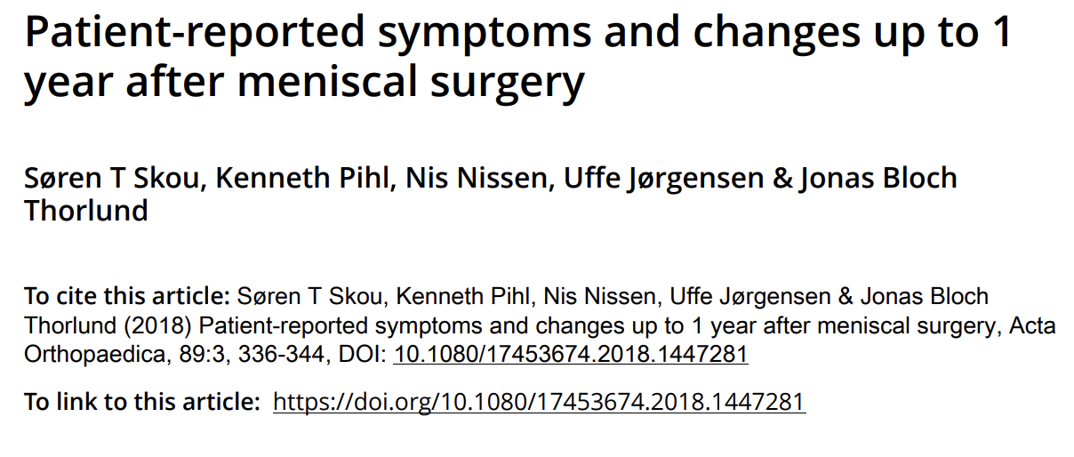
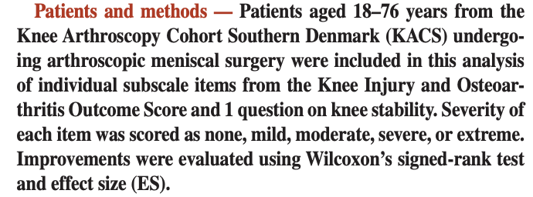
Meniscal tear
Notes:
A cohort study is optimal to answer this question.

Slide 30
Meniscal tear
Notes:
(an RCT also gives us this information – although it is not optimally powered to do that.)
CHALLENGE: What portion of patients who undergo meniscectomy will have osteoarthritis in 10 years? Would be impractical to answer that question with an RCT…. So even though cohort studies are “lower” on the evidence pyramid, they can be the ideal study to answer particular types of questions.

Slide 31
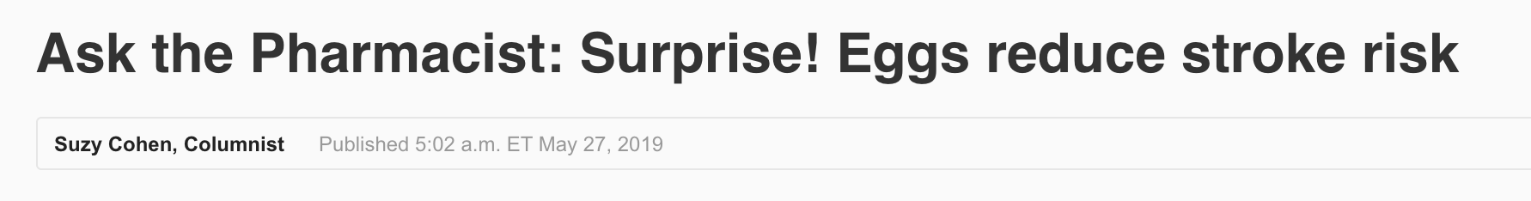
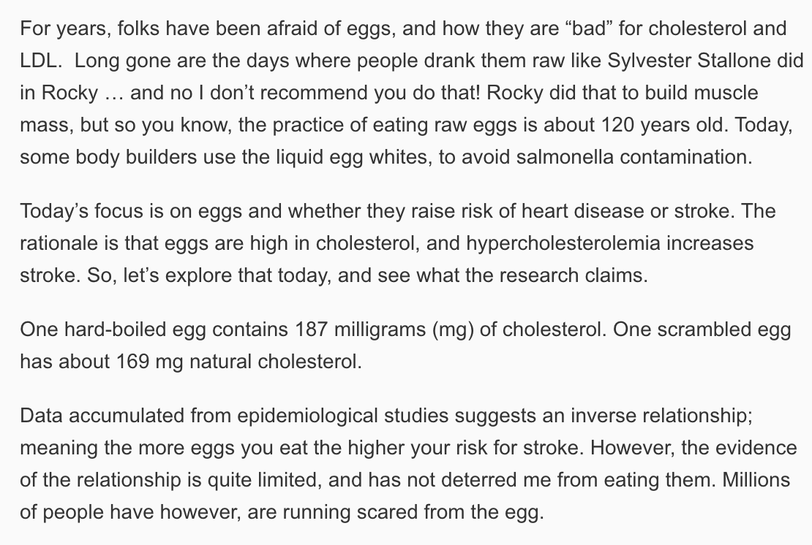
ASK – What are some categories of questions?
Source: USA Today
@UtahIMCMRs
#EBM
Notes:
Example: New reports – eggs cause stroke (what kind of study should you have to support that)?
You ideally want an RCT – because it controls for unmeasured confounders (which we will discuss later)
Be careful of causal language in cohort studies – it is difficult to say what CAUSED something, easy to say they were ASSOCIATED. Nutritional epidemiology is notorious for this – possibly this explains the high rate of medical reversal in that field?
When can you determine causality?
What are some situations where we can’t run an RCT?

Slide 32
ASK – What are some categories of questions?
Differential Diagnosis
Diagnosis
Prognosis
Therapy (Cohort?)
Harm
Source: https://guides.dml.georgetown.edu/ebm
@UtahIMCMRs
#EBM
Notes:
Ideally, should have a trial if you are making claims about therapy effectiveness.

Slide 33
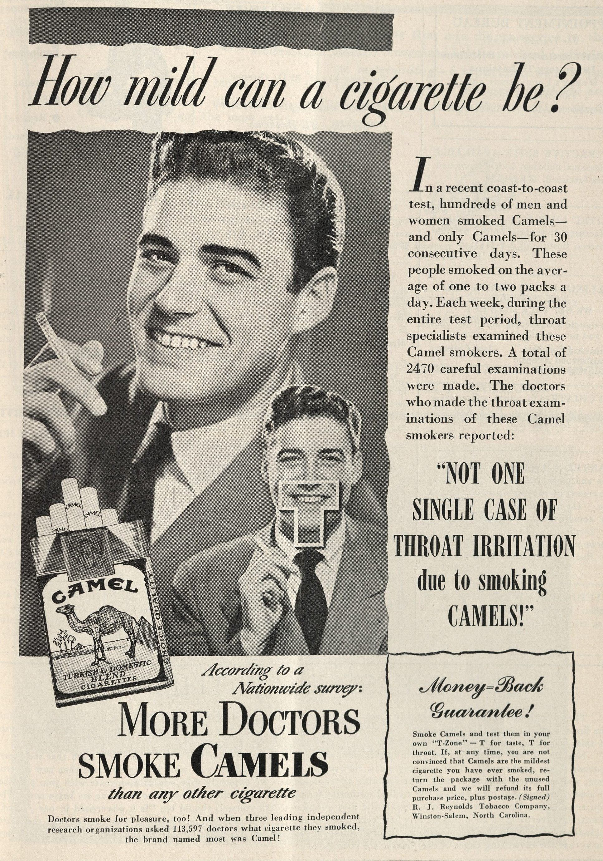
EBCP in action
Historical Detour: Smoking and Lung Cancer
New England Journal of Medicine
Volume 240, Number 17, April 28, 1949
Notes:
Lung cancer: we’ve never run a RCT on smoking causing lung cancer, and we never will. Why? (logistics, feasibility of randomization, now lack of clinical equipoise)
How did we come to understand the causative association of this?
(Big picture for this story is… why are cohort studies still relevant?

Slide 34
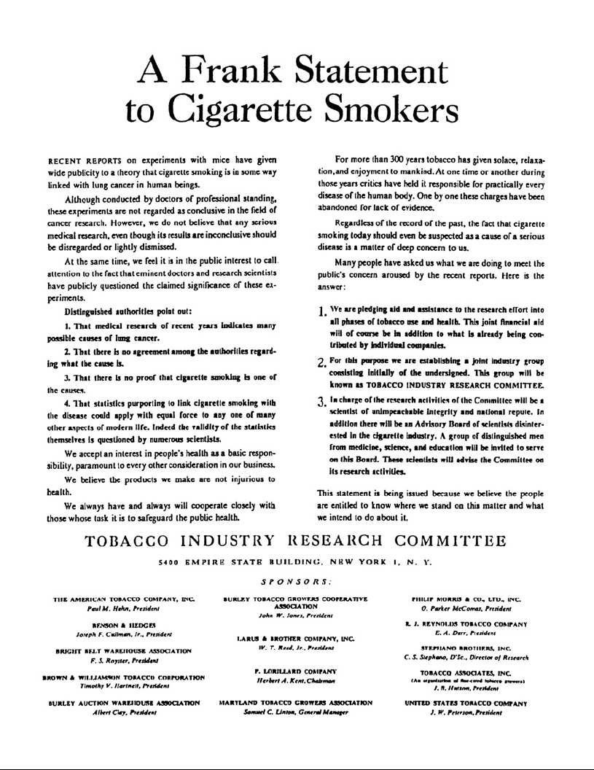
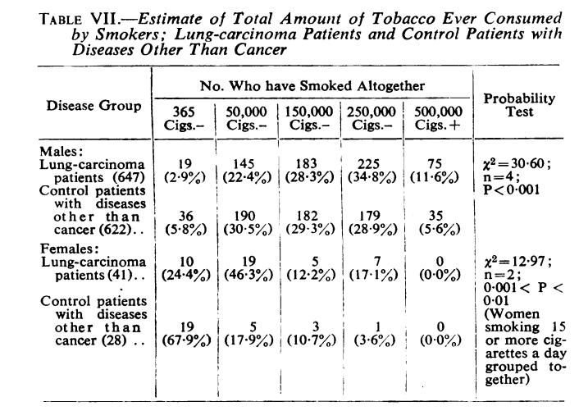
EBCP in action
Historical Detour: Smoking and Lung Cancer
A Bradford Hill and Richard Doll (BMJ, 1950)
Case-control Study – smokers more likely
to develop lung cancer.
Notes:
Lung cancer:
Retrospective Case-control studies had been performed before the 1950s. American Cancer Society and prominent biostatisticians were skeptical of a link. (They invoked reverse-causation)
Major American tobacco companies were in a war to discredit science:
A Frank Statement to Cigarette Smokers was a historic first advertisement in a campaign run by major American tobacco companies on January 4, 1954, to create doubt by disputing recent scientific studies linking smoking cigarettes to lung cancer and other dangerous health effects. (Wikipedia)
A Frank Statement to Cigarette Smokers claims:
That medical research of recent years indicates many possible causes of lung cancer.
That there is no agreement among the authorities regarding what the cause is.
That there is no proof that cigarette smoking is one of the causes.
That statistics purporting to link cigarette smoking with the disease could apply with equal force to any one of many other aspects of modern life. Indeed, the validity of the statistics themselves is questioned by numerous scientists.
How do you prove causation?
RCT? Unethical, impractical.

Slide 35
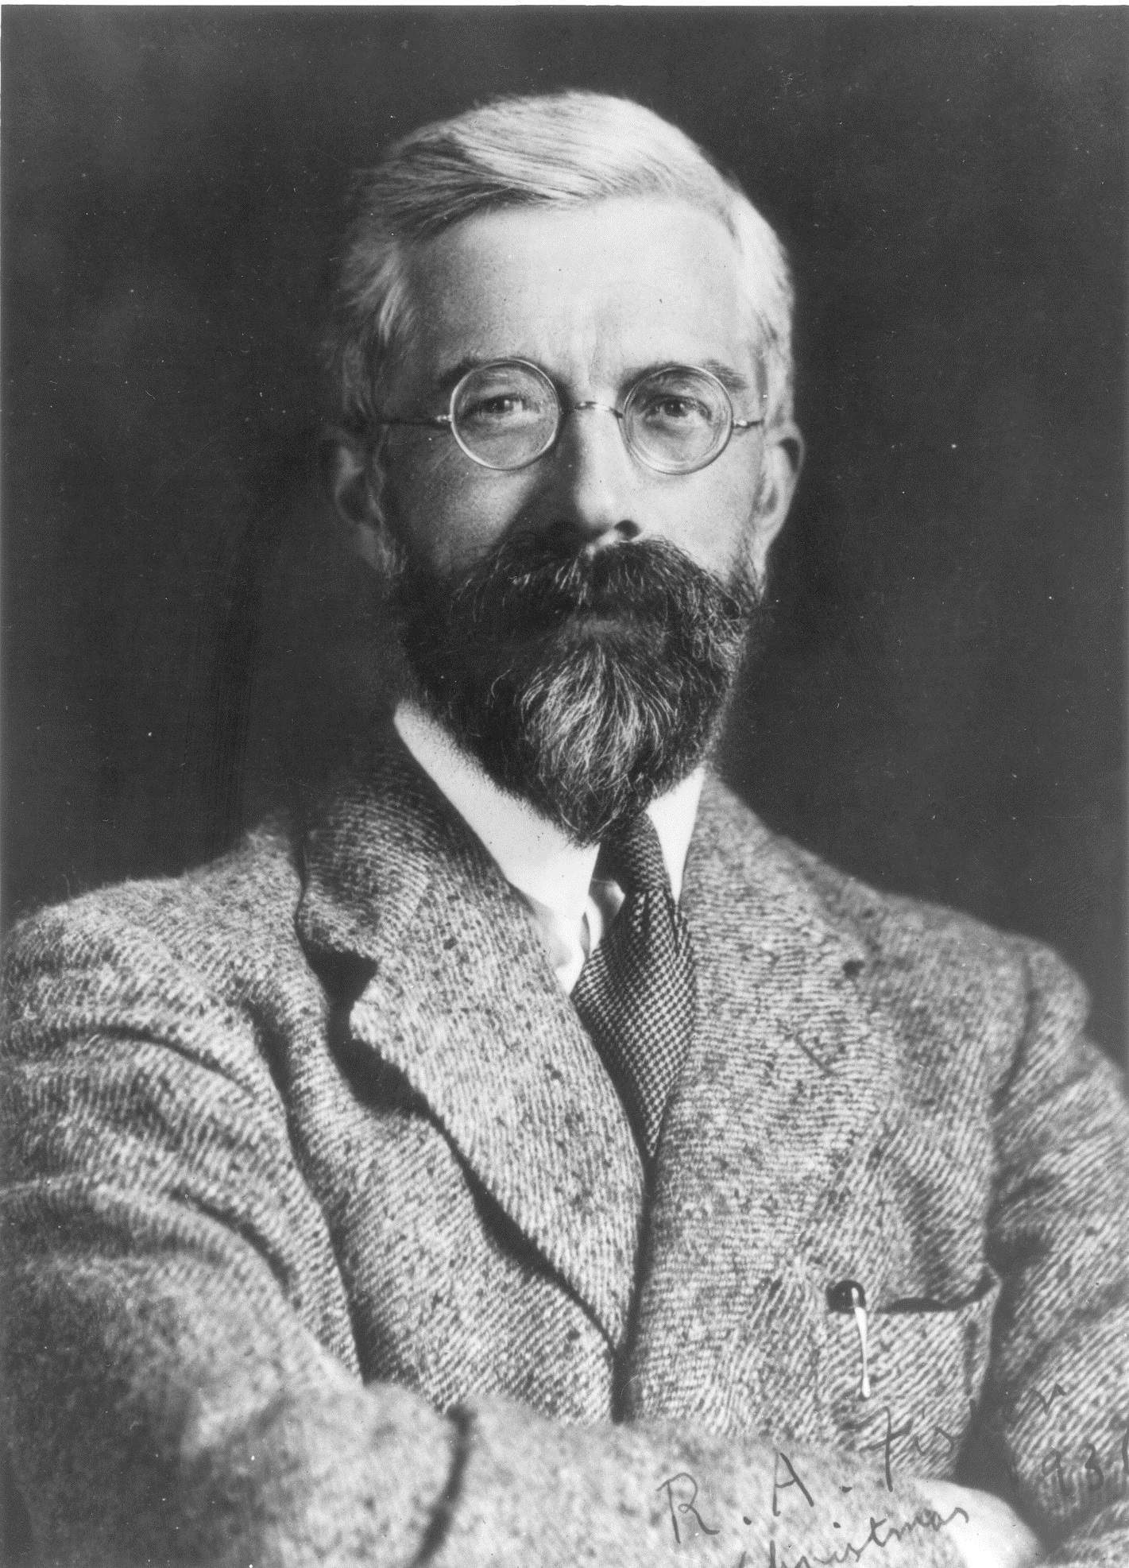
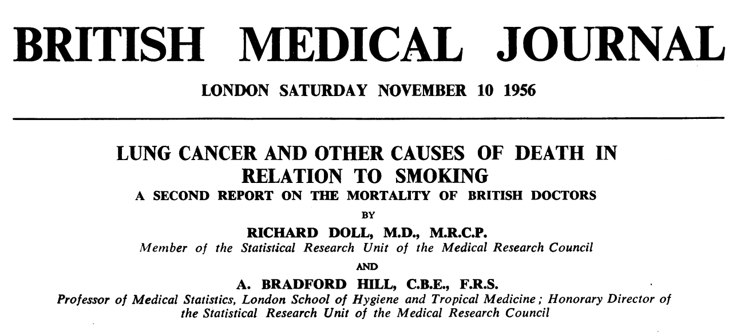
EBCP in action
Historical Detour: Smoking and Lung Cancer
RA Fisher: Blamed Confounders
*Conflicts of interest
Notes:
Bradford Hill and Richard Doll: authored the British Doctors’ Study -> sent all physicians a questionnaire: do you smoke (or did you used to, but have you quit), then total amount smoked. -> follow 41,000 responses. American Cancer Study was similar, but larger.
This is how the cohort study was invented!
Prominent statisticians were not impressed: RA Fisher (inventor of the ANOVA statistical method, possibly the most famous statistician of the time) strongly dissented to the findings, insisting that unmeasured confounders (possibly there is a genetic cause of both smoking and predisposition to lung cancer) explained the findings… and continued to endorse smoking. “Correlation does not imply causation” Also: He had conflict of interest (money from tobacco companies but he thought he was too smart to be swayed)… so maybe the takeaway is that there are lies, damned lies, and statistics.

Slide 36
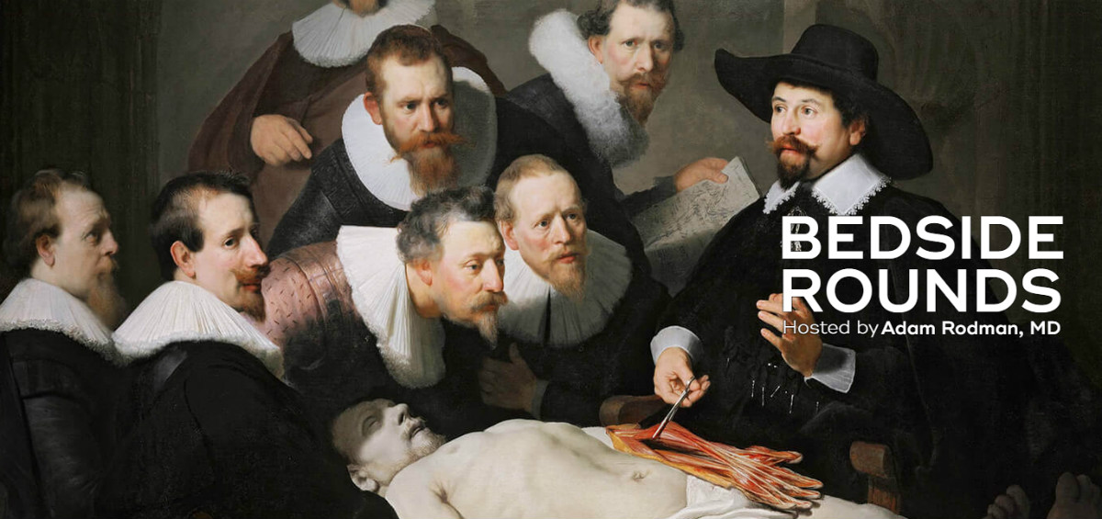
EBCP in action
Historical Detour: Smoking and Lung Cancer
Bradford Hill Criteria (Proceedings of the Royal Society of Medicine, 58 (1965), 295-300.)
Strength (Effect Size)
Consistency (Reproducibility)
Specificity
Temporality
Dose-response
Plausibility
Coherence
Experiment (when possible)
Analogy
+/- Reversibility
Notes:
This battle over the reliability of cohort studies in determining causality led to the famous Bradford Hill criteria – quite important, as 1/3 of increase in life expectancy second half of in 20th century alone is attributed to smoking cessation
Strength (effect size): A small association does not mean that there is not a causal effect, though the larger the association, the more likely that it is causal.
Consistency (reproducibility): Consistent findings observed by different persons in different places with different samples strengthens the likelihood of an effect.
Specificity: Causation is likely if there is a very specific population at a specific site and disease with no other likely explanation. The more specific an association between a factor and an effect is, the bigger the probability of a causal relationship.^{[1]}
Temporality: The effect has to occur after the cause (and if there is an expected delay between the cause and expected effect, then the effect must occur after that delay).
Biological gradient: Greater exposure should generally lead to greater incidence of the effect. However, in some cases, the mere presence of the factor can trigger the effect. In other cases, an inverse proportion is observed: greater exposure leads to lower incidence.^{[1]}
Plausibility: A plausible mechanism between cause and effect is helpful (but Hill noted that knowledge of the mechanism is limited by current knowledge).
Coherence: Coherence between epidemiological and laboratory findings increases the likelihood of an effect. However, Hill noted that "... lack of such [laboratory] evidence cannot nullify the epidemiological effect on associations".
Experiment: "Occasionally it is possible to appeal to experimental evidence".
Analogy: The use of analogies or similarities between the observed association and any other associations.
Some authors consider also, the Reversibility: If the cause is deleted then the effect should disappear as well

Slide 37
EBCP in action
You’re now working at the FDA, and a new trial, RALES, has shown that spironolactone is helpful in HFrEF reduced morality “relative risk of death, 0.70; 95 percent confidence interval, 0.60 to 0.82; P<0.001” with “The incidence of serious hyperkalemia was minimal in both groups of patients.” It’s approved… are we sure it’s safe?
Notes:
What kind of studies do we need?

Slide 38
ASK – What are some categories of questions?
Differential Diagnosis
Diagnosis
Prognosis
Therapy
Harm (RCT?, Cohort)
Source: https://guides.dml.georgetown.edu/ebm
@UtahIMCMRs
#EBM
Notes:
Ongoing monitoring of the cohort of patients who are on it. = “Phase 4 trial” in FDA approval parlance.
RCT (e.g. phase 3 trial) can be enough if it is a common, obvious effect. However we need LARGE trials to catch rare or subtle effects IN ACTUAL USE, in the population.

Slide 39
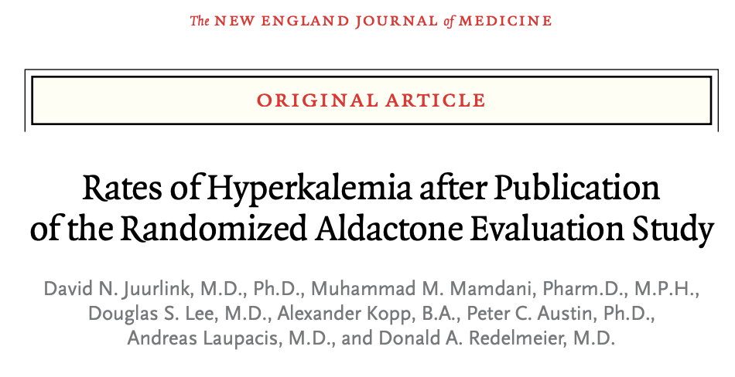
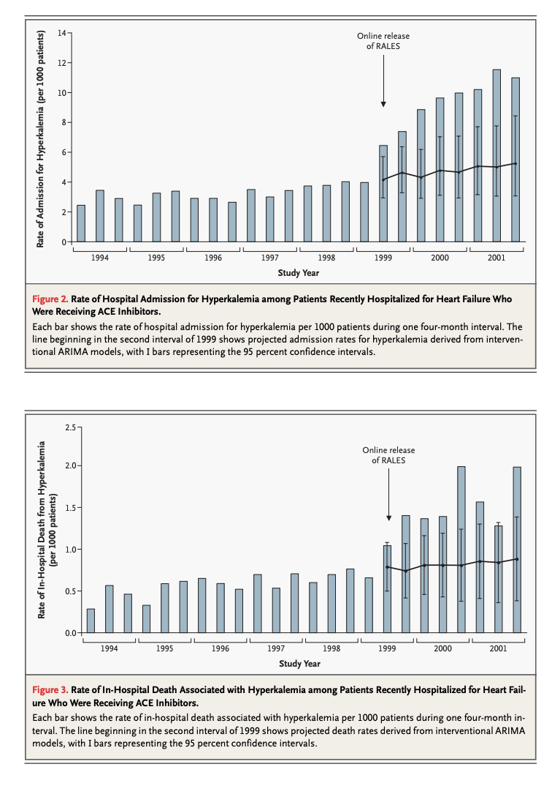
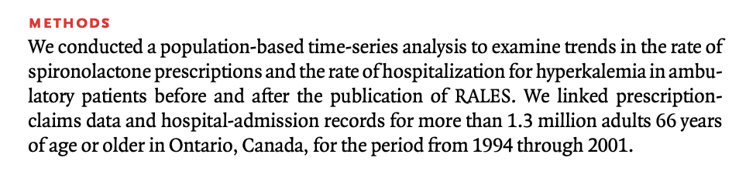
ASK – HARM in clinical practice?
@UtahIMCMRs
#EBM
Notes:
Rates of adverse reactions to medications are too low to be adequately detected in phase 3 trials. (hence the Phase IV trial.. Which is essentially an ongoing cohort study)
Example: Hyperkalemia with aldosterone blockade -> increased mortality from hyperkalemia after release of RALES study (RCT showed mortality benefit in HFrEF) due to increase prescriptions for spironolactone. In real life, patients were not followed as strictly as in the study protocol – subsequent strict recommendation AGAINST usage if eGFR < 30, sCr 2.5+, or K over 5 on any recent lab draw (ACC/AHA guidelines)
Note: Another good example of cohort studies identifying harm missed in RCTs could be…
Hcv tx w sofosbuvir and lamivudine... Hep b reactivation occurs- no idea bc they were excluded from the other trials

Slide 40
EBM / EBCP – Foreground/Primary lit.
4 A’s
Ask: A specific (e.g. PICO) question
Acquire: the right type of study/resource
Assess
Apply
Source: Rosenberg W, Donald A. Evidence based medicine: An approach to clinical problem-solving. BMJ. 1995;310:1122-1126
Notes:
The old model of looking for an individual study to answer your clinical question is outdated for two reasons – thus, I will encourage you to NOT spend your time in clinic looking for individual studies except in cases where you are getting very granular (e.g. a research presentation).
I’ve still included the preceding discussion because it’s how knowledge is generated, and therefore mandatory to know (in terms of knowing the limitations of data)

Slide 41
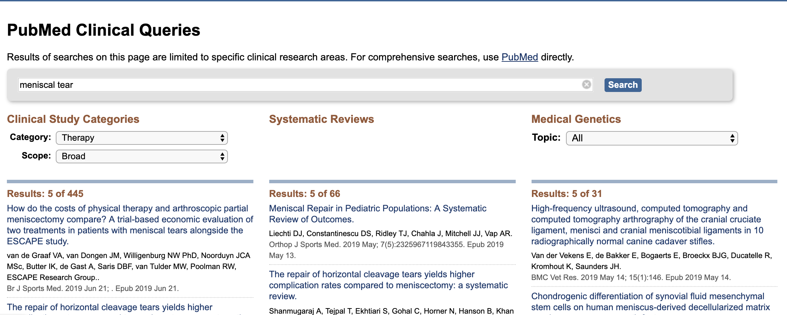
Finding primary literature
Pubmed Clinical Inquiries: https://www.ncbi.nlm.nih.gov/pubmed/clinical
Notes:
Hidden, because outside of research, residents should not be using primary literature sources to answer clinical questions.

Slide 42
Finding primary literature
Stay aware of new, major primary literature
Skim journals
ACP Journal Club
Twitter

Slide 43
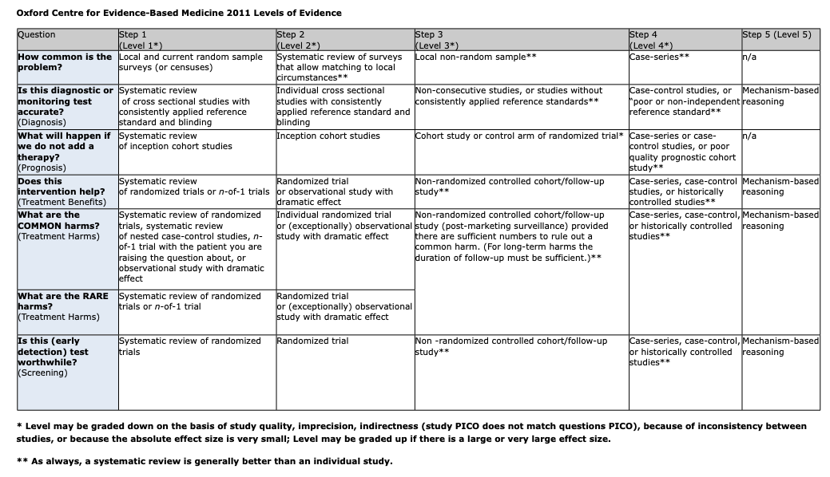
ASK – Summary of Primary literature
Best for foreground questions
Formulate a precise question: PICO format
Search for the correct study design
@UtahIMCMRs
#EBM

Slide 44
Learning objectives
Understand how and why EBM is useful to you as a trainee
Practice a structured approach to answering clinical questions
Understand Primary vs Secondary/Tertiary medical literature
Understand validity, and identify common threats to validity (Bias, Confounding, Chance)
Understand (in a non-mathy way) how Bayes Theorem can be applied to diagnosis
Understand relevant metrics to assess treatment effects.
Be able to access several useful secondary literature sources quickly, at the point of care.
@UtahIMCMRs
#EBM

Slide 45
Why not look for primary literature?
0.4 - 0.8 clinical questions per patient
2/3 left unanswered
<5 minutes to answer
JAMA Intern Med. 2014 May;174(5):710-8. doi: 10.1001/jamainternmed.2014.368. Clinical questions raised by clinicians at the point of care: a systematic review. Del Fiol G1, Workman TE2, Gorman PN3.
@UtahIMCMRs
#EBM
Notes:
Reason #1: Ain’t nobody got time for that!
Time to answer: 241 seconds uptodate, 291 seconds pubmed
\
This systematic review estimates that the per-patient frequency of questions raised by clinicians ranges from 0.4 and 0.8 and that roughly two-thirds of these questions are left unanswered.
JAMA Intern Med. 2014 May;174(5):710-8. doi: 10.1001/jamainternmed.2014.368. Clinical questions raised by clinicians at the point of care: a systematic review. Del Fiol G1, Workman TE2, Gorman PN3.
Nobody can read 0.4 to 0.8 studies on each patient, all day every day. We need a bullet point that tells us the quick and dirty in 1 paragraph.

Slide 46
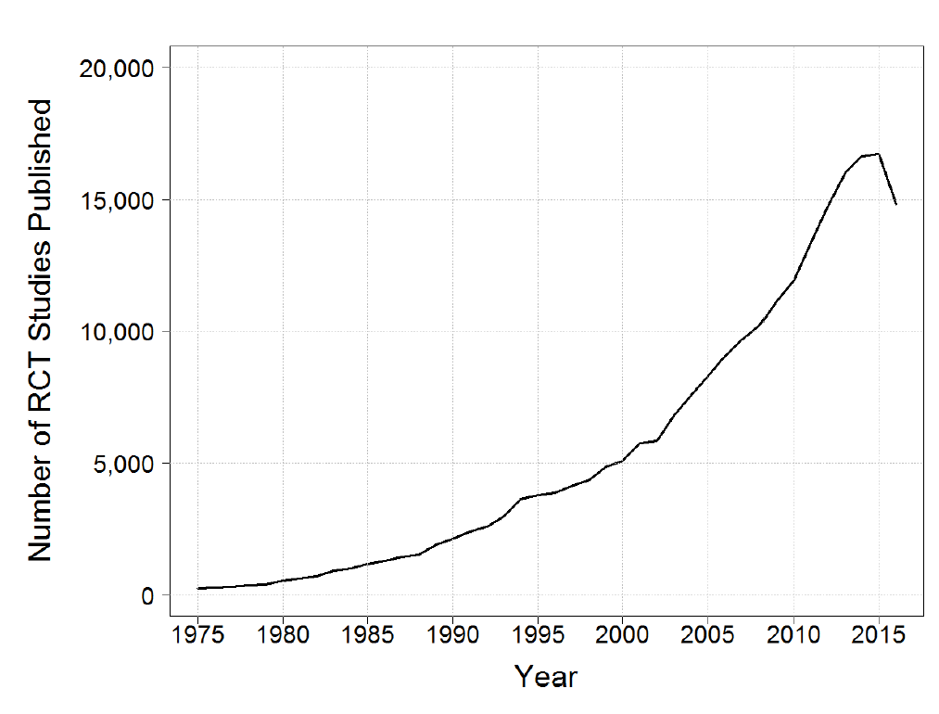
Why not look for primary literature?
http://dan.corlan.net/medline-trend.html
@UtahIMCMRs
#EBM
Notes:
Reason number 2: there is too much literature (especially for a generalists – whether a trainee or not). Outside of staying current on a very focused area of medicine, if you are reading trials, you will be missing important practice changing updates.
46 RCTs published everyday (as indexed by pubmed). Similarly - over 19 000 systematic reviews were indexed on PubMed in 2017
From Harris: “You will leave this institution a good physician, almost if you like it or not. You are drinking from the fire hose! You will leave residency as a good physician. The DAY you leave there will be more than 46 RTCs published, DAY ONE. From that point on you’re behind. Some of those will matter and by the end of year one you’ve fallen behind on some aspect of your practice. You can no longer read one or two journals and pretend that you’re keeping up with any aspect of medical practice (http://dan.corlan.net/medline-trend.html). “

Slide 47
ASK – What kind of questions do I ask?
General Knowledge about a condition
Specific knowledge: applied to patient or population
Foreground questions
Background questions
Novice
Expert
https://guides.ucsf.edu/infolitUCSF
@UtahIMCMRs
#EBM
Notes:
Background questions ask for general knowledge about an illness, disease, condition, process or thing. These types of questions typically ask who, what, where, when, how & why about things like a disorder, test, or treatment, etc.
For example
How overweight is a woman to be considered slightly obese?
What are the clinical manifestations of menopause?
What causes migraines?
Foreground questions ask for specific knowledge to inform clinical decisions. These questions typically concern a specific patient or particular population. Foreground questions tend to be more specific and complex compared to background questions. Quite often, foreground questions investigate comparisons, such as two drugs, two treatments, two diagnostic tests, etc. Foreground questions may be further categorized into one of 4 major types: treatment/therapy, diagnosis, prognosis, or etiology/harm.
For example
Is Crixivan effective when compared with placebo in slowing the rate of functional impairment in a 45 year old male patient with Lou Gehrig's Disease?
In pediatric patients with Allergic Rhinitis, are Intranasal steroids more effective than antihistamines in the management of Allergic Rhinitis symptoms?
Foreground questions: more likely to be answered in primary literature.
Background questions; more likely to be answered in synthesis.

Slide 48
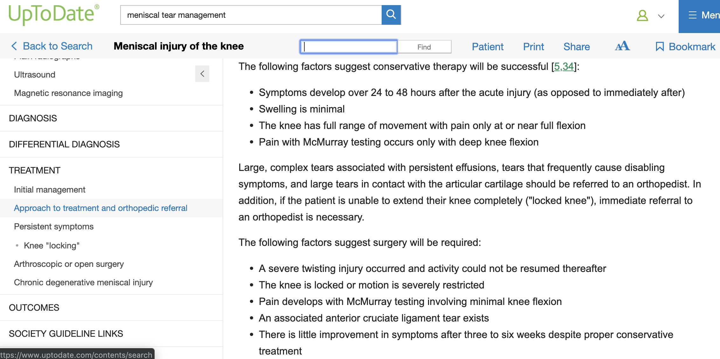
Secondary literature
More questions are answered using UpToDate than PubMed on all major medical topics
J Med Internet Res. 2008 Oct-Dec; 10(4): e29. PMID: 18926978 Answers to Questions Posed During Daily Patient Care Are More Likely to Be Answered by UpToDate Than PubMed A Hoogendam, et al
Notes:
Note: there is more nuance in this article, but less empiric support.
We’ll return to the assessment of reliability later.
Specialists and residents in internal medicine generally use less than 5 minutes to answer patient-related questions in daily care. More questions are answered using UpToDate than PubMed on all major medical topics.
Answers to Questions Posed During Daily Patient Care Are More Likely to Be Answered by UpToDate Than PubMed. https://www.ncbi.nlm.nih.gov/pmc/articles/PMC2629368/
J Med Internet Res. 2008 Oct-Dec; 10(4): e29. PMID: 18926978 Answers to Questions Posed During Daily Patient Care Are More Likely to Be Answered by UpToDate Than PubMed A Hoogendam, et al

Slide 49
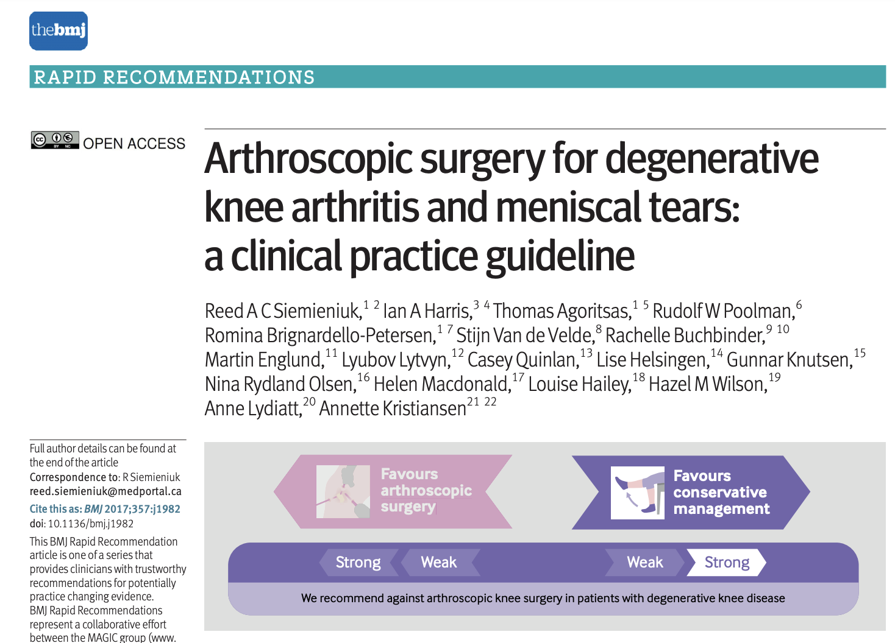

Secondary literature
Notes:
Example secondary literature sources:
Cochrane
Uptodate
Society Guidelines (RIP Guideline clearinghouse)

Slide 50
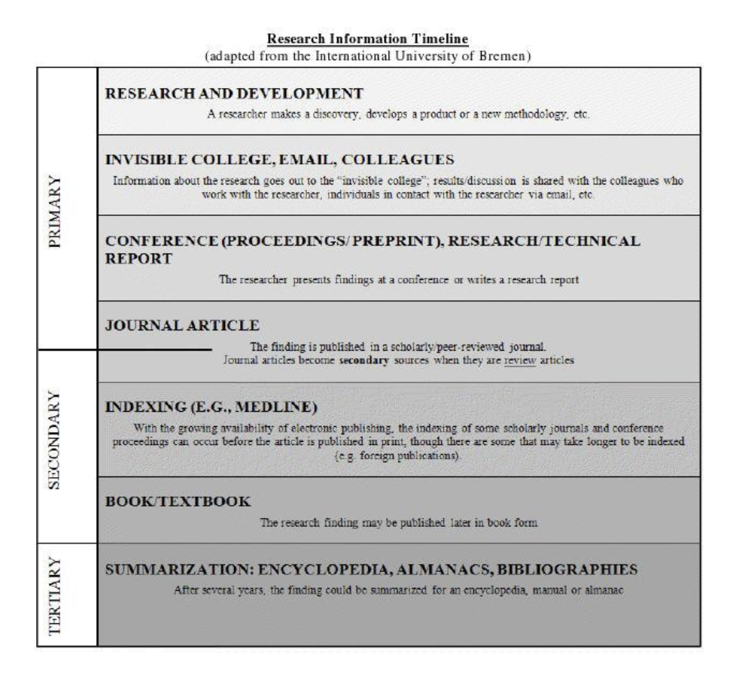
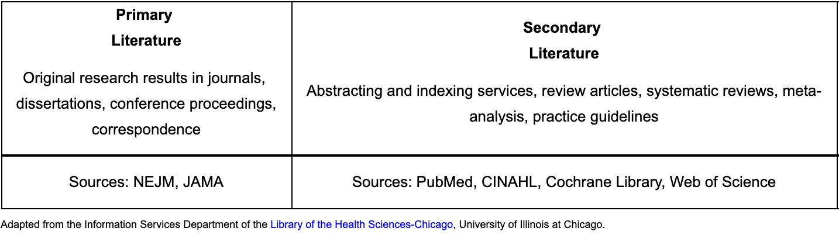
What is “the medical literature?”
@UtahIMCMRs
#EBM
Notes:
Primary Literature Primary sources are original materials. It is authored by researchers, contains original research data, and is usually published in a peer-reviewed journal. Primary literature may also include conference papers, pre-prints, or preliminary reports.
Secondary Literature Secondary literature consists of interpretations and evaluations that are derived from or refer to the primary source literature. Examples include review articles (specifically meta-analysis and systematic reviews) and reference works. Professionals within each discipline take the primary literature and synthesize, generalize, and integrate new research.
Tertiary Literature Tertiary literature consists of a distillation and collection of primary and secondary sources such as textbooks, encyclopedia articles, and guidebooks or handbooks. The purpose of tertiary literature is to provide an overview of key research findings and an introduction to principles and practices within the discipline
https://research.library.gsu.edu/c.php?g=115556&p=752623
NOTE: still need to understand the primary literature, as this is where the data comes from and someone has to be ensuring it is valid (possibly, but probably shouldn’t exclusively be, specialists)

Slide 51
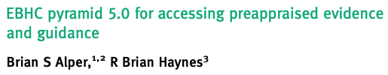
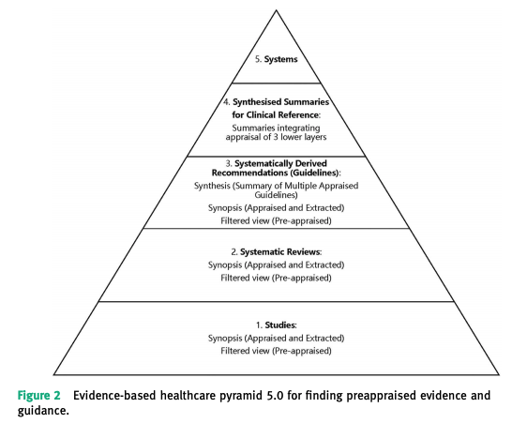
What is “the medical literature?”
@UtahIMCMRs
#EBM
Notes:
Not that we need more pyramids - but that higher levels of the pyramid are close to the point of clinical care’
Systems: computerized decision support (e.g. prompts in the EMR to order Ddimer in low risk by wells patient undergoing CTPE)
Synthesized summaries.: Current resources providing synthesized summaries for clinical reference with varying degrees of quality, currency and comprehensiveness include BMJ Best Practice, DynaMed Plus, EBM Guidelines, Essential Evidence Plus and UpToDate.
[ ] todo: And exercise … for example find the best source of evidence to tell us whether we should put it in nasogastric tube, pneumonia tx (no recent guideline)

Slide 52
Secondary/Tertiary literature
Dynamed Plus
Uptodate
In the clinic (AIM)
NEJM Subject Review
Cochrane
USPSTF
JAMA Evidence
ACR Approp. Criteria
NNT
@UtahIMCMRs
#EBM
Notes:
Timeout – to set these up!
See links in separate word document:

Slide 53
Learning objectives
Understand how and why EBM is useful to you as a trainee
Practice a structured approach to answering clinical questions
Understand Primary vs Secondary/Tertiary medical literature
Understand validity, and identify common threats to validity (Bias, Confounding, Chance)
Understand (in a non-mathy way) how Bayes Theorem can be applied to diagnosis
Understand relevant metrics to assess treatment effects.
Be able to access several useful secondary literature sources quickly, at the point of care.
@UtahIMCMRs
#EBM

Slide 54
ASSESS

Slide 55
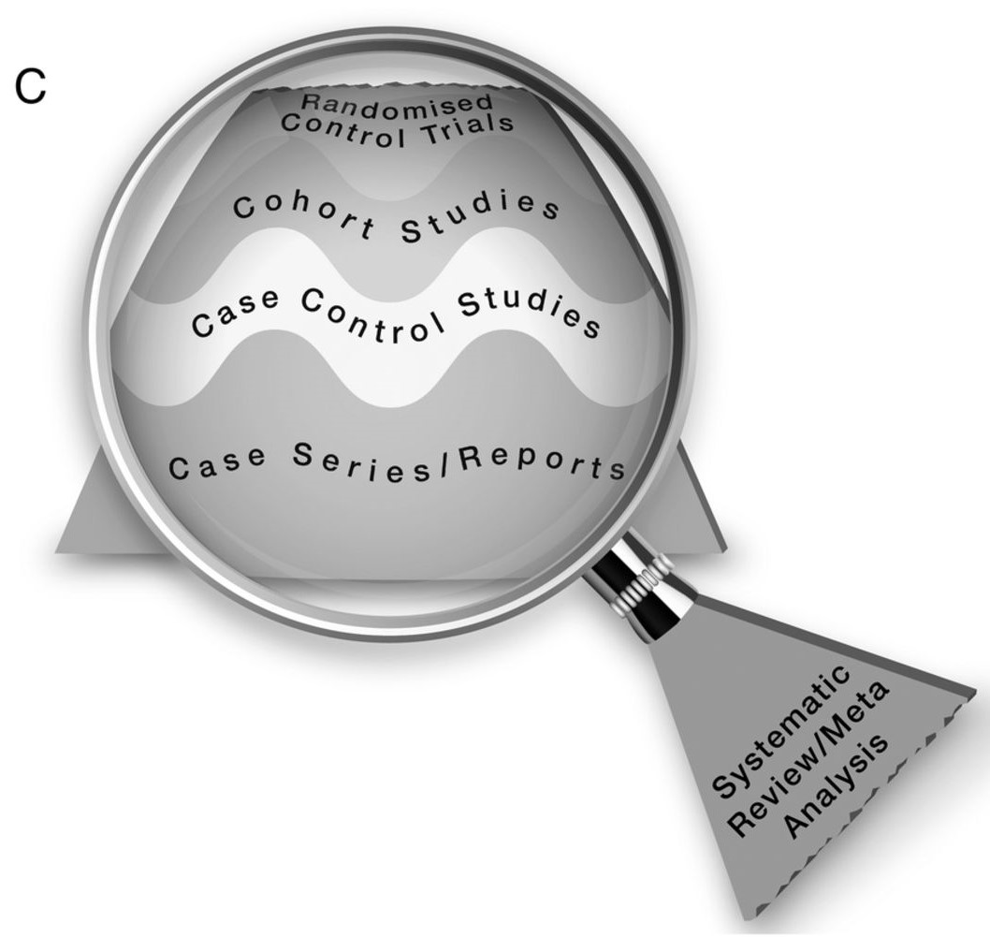
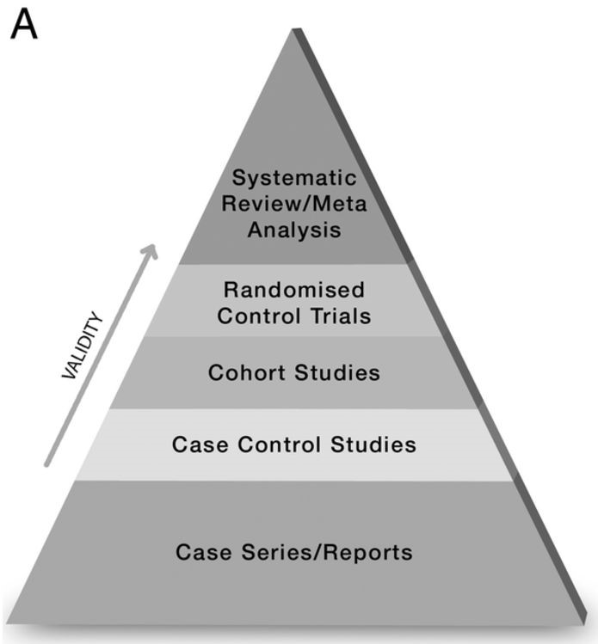
Assess – hierarchy of Strength of evidence
BMJ: http://ebm.bmj.com/content/early/2016/06/23/ebmed-2016-110401
Notes:
Secondary literature is the lens we view the pyramid through
Also, the validity does not break down in a simple way like the pyramid suggests

Slide 56
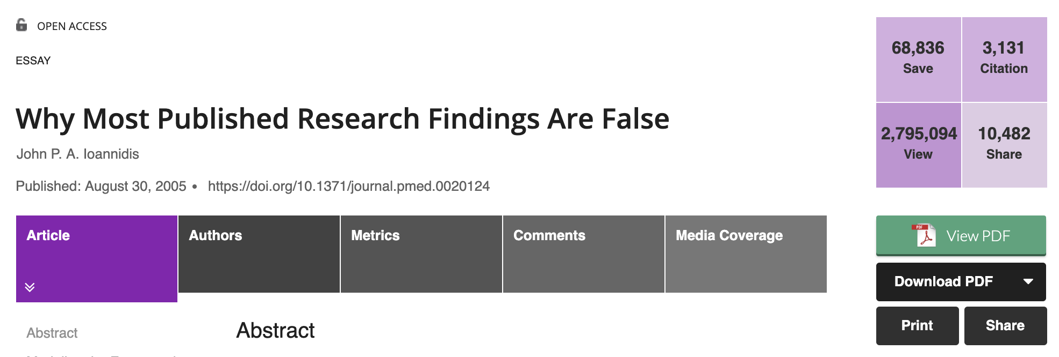
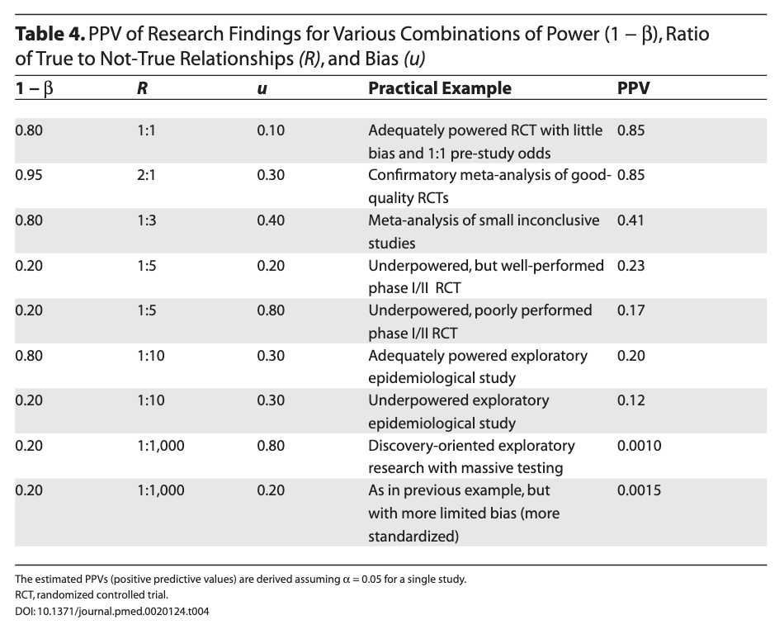
EBM is hard
Notes:
Physicians generate questions that RCTs answer. Meta-analyses and Guidelines aggregate those results. Then we apply those results in practice… where do things go wrong in this process?
[ ] TODO : this section could easily be expanded to talk about common issues with the medical literature, including:
-lack of reproducibility (e.g. in social science, univ of Utah conference)
-medical reversal questioning the reliability of our findings (Ending Medical Reversal by Adam Cifu and Vinnay Prasad). Page 87 from medical reversal = summarized key evidence from 1 decade of NEJM and the BMJ -> 54% of practices are effective, 35% are ineffective. old adage of 50% of what we learn in med school is wrong… pretty close.
-bias in the studies that are published, and changing of endpoints (such as P-hacking) – addressed by preregistration of trials – clinicaltrials.gov
-retractionwatch: https://retractionwatch.com/
Ioannidis 2005 (https://doi.org/10.1371/journal.pmed.0020124) why most published research is wrong article is the most downloaded items in the public library of science. Highly recommended for those interested in meta-research
Argument: The probability that a research claim is true depends on: study power, bias, replication, and the ratio of true to not true relationships in a field of inquiry (e.g. the pretest probability). Essentially – he is making the point that we expected to have false positive and negatives. if you calculate the odds of a research finding being true beforehand * the ”power of the study, and the risk of bias” – you find that the positive predictive value of most studies is not very good.
(Extraordinary claims require extraordinary evidence)
If this reasoning doesn’t make sense – don’t worry, we will return to it during the Bayes theorem discussion.

Slide 57
Learning objectives
Understand how and why EBM is useful to you as a trainee
Practice a structured approach to answering clinical questions
Understand Primary vs Secondary/Tertiary medical literature
Understand validity, and identify common threats to validity (Bias, Confounding, Chance)
Understand (in a non-mathy way) how Bayes Theorem can be applied to diagnosis
Understand relevant metrics to assess treatment effects.
Be able to access several useful secondary literature sources quickly, at the point of care.
@UtahIMCMRs
#EBM
Notes:
[ ] TODO: this was by far the driest section – figure out a way to incorporate a case or activity here.

Slide 58
Validity
Internal validity
Is this a real effect in the people studied?
External validity
If true, would this generalize from the study population to the population I’m interested in
Notes:
Internal Validity: degree to which manipulating the independent variable (e.g. treatment received in an RCT) explains any difference between study groups. (e.g. did people really live longer because I gave them a statin (high internal validity) or for some other reason (low internal validity) in JUPITER.
External Validity: the extent which results generalize from the study population to the study of interest

Slide 59
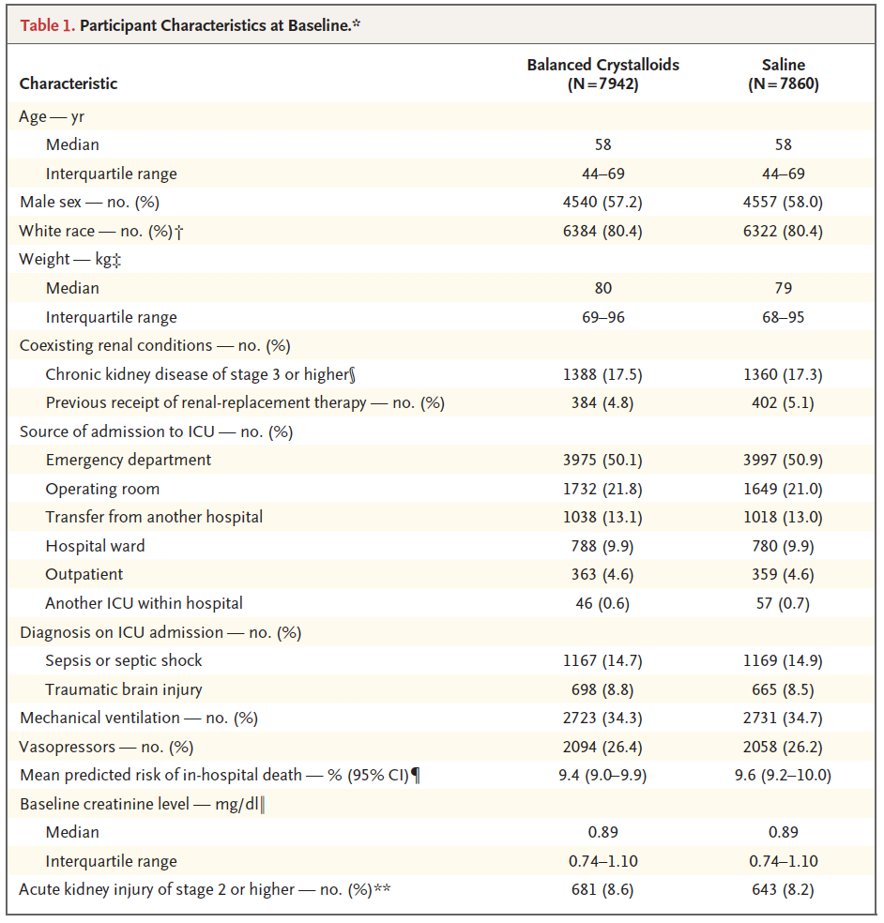
Threats to Validity
Internal validity
Confounding
Chance
Statistical Regression
Happenstance (”P > 0.05”)*
Bias
External validity (Generalizability)
Population validity
Ecological Validity
Bias
Source: SMART Trial NEJM 2018
Notes:
*Assessing various threats to validity is the primary reason for reporting of table 1 in clinical trials*
Bias: A systematic error in the design, recruitment, data collection or analysis that results in a mistaken estimation of the true effect of the exposure and the outcome.
Confounding: A situation in which the effect or association between an exposure and outcome is distorted by the presence of another variable. Positive confounding (when the observed association is biased away from the null) and negative confounding (when the observed association is biased toward the null) both occur.
Statistical regression: An effect that is the result of a tendency for subjects selected on the bases of extreme scores to regress towards the mean on subsequent tests.
Happenstance * P-value interpretation is difficult and a matter of debate / banter in the scientific community. However, the idea of a statistical fluke is important
Population: how representative of a population is the study sample? (e.g. –do the inclusion criteria make it more likely that only healthy patients are included?)
Ecological: do the study methods approximate reality (e.g. the RALES study mentioned earlier)

Slide 60
Threats to Validity
Bias, Confounding, or Chance?
In a cohort of elderly patients, those treated with Vit D died more often. However, it was later discovered that frail patients were indoors (and thus Vit D deficient) and thus more likely to be treated with Vit D, and to die.
Source: SMART Trial NEJM 2018
Notes:
https://newonlinecourses.science.psu.edu/stat507/node/34/

Slide 61
Threats to Validity
Bias, Confounding, or Chance?
In a cohort of elderly patients, those treated with Vit D died more often. However, it was later discovered that frail patients were indoors (and thus Vit D deficient) and thus more likely to be treated with Vit D, and to die.
How can studies avoid this?
Source: SMART Trial NEJM 2018
Notes:
Strategies include:
Matching, stratifying, or accounting (e.g. multivariate analysis) for known confounders
OR
Randomization = accounts for both known and unknown confounders (e.g. frailty of patients wouldn’t affect how likely they are to get Vitamin D)
From Penn State link:
If the method used to select subjects or collect data results in an incorrect association, .
THINK >> Bias!
If an observed association is not correct because a different (lurking) variable is associated with both the potential risk factor and the outcome, but it is not a causal factor itself,
THINK >> Confounding!
If an effect is real but the magnitude of the effect is different for different groups of individuals (e.g., males vs females or blacks vs whites).
THINK >> Effect modification!

Slide 62
Threats to Validity
Bias, Confounding, or Chance?
Patients who receive PCI for NSTEMI are less likely at follow-up to receive repeat testing, and therefore less likely to be counted as having a MACE then medical management.
Source: SMART Trial NEJM 2018

Slide 63
Threats to Validity
Bias, Confounding, or Chance?
Patients who receive PCI for NSTEMI are less likely at follow-up to receive repeat testing, and therefore less likely to be counted as having a MACE then medical management.
How can studies avoid this?
Source: SMART Trial NEJM 2018
Notes:
Blinding investigators to the treatment.

Slide 64
Threats to Validity
Bias, Confounding, or Chance?
Of 10 patients who have a rare cancer and are treated with a phase 1 experimental agent, 5 respond favorably (vs 1). P = 0.04 The compound later shows no effect in phase 3
How can studies avoid this?
Source: SMART Trial NEJM 2018
Notes:
Larger study, bigger effect, etc.
p Value expresses the reliability of the study. A p value of 0.05 (accepted standard for statistically significant) means that the likelihood of these results happening due to chance alone is 5%. This means that 1 in 20 studies are not accurate with a p value of 0.05. p value of <0.001 is better.
Power (1-B): likelihood of detecting a difference if there is one.
Effect size: our best guess for the magnitude of an effect. Imagine the yellow curve is the distribution of measured blood pressures with chlorthalidone and purple is the measured blood pressures of patients on HCTZ. D= 0.5 -> small difference., d=3 -> large difference (meaning, chlorthalidone is much better). Note that this is different than probability.
95% Confidence Interval: a range where we are 95% sure the true value lies within this.

Slide 65
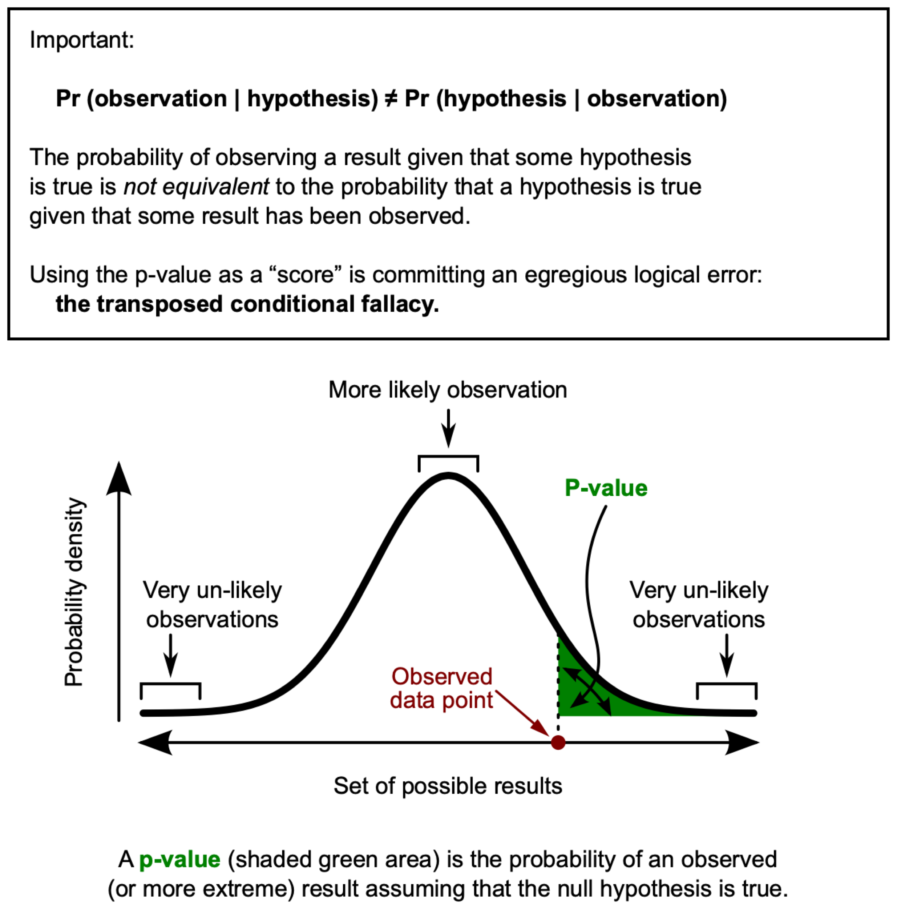
Statistics - Terms
P-Value (alpha)
Effect Size
Power
Confidence Interval
Notes:
Hidden – too in the weeds
p Value expresses the reliability of the study. A p value of 0.05 (accepted standard for statistically significant) means that the likelihood of these results happening due to chance alone is 5%. This means that 1 in 20 studies are not accurate with a p value of 0.05. p value of <0.001 is better.
Power (1-B): likelihood of detecting a difference if there is one.
Effect size: our best guess for the magnitude of an effect. Imagine the yellow curve is the distribution of measured blood pressures with chlorthalidone and purple is the measured blood pressures of patients on HCTZ. D= 0.5 -> small difference., d=3 -> large difference (meaning, chlorthalidone is much better). Note that this is different than probability.
95% Confidence Interval: a range where we are 95% sure the true value lies within this.

Slide 66
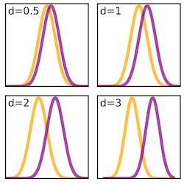
Statistics - Terms
P-Value (alpha)
Effect Size
Power
Confidence Interval
Notes:
p Value expresses the reliability of the study. A p value of 0.05 (accepted standard for statistically significant) means that the likelihood of these results happening due to chance alone is 5%. This means that 1 in 20 studies are not accurate with a p value of 0.05. p value of <0.001 is better.
Power (1-B): likelihood of detecting a difference if there is one.
Effect size: our best guess for the magnitude of an effect. Imagine the yellow curve is the distribution of measured blood pressures with chlorthalidone and purple is the measured blood pressures of patients on HCTZ. D= 0.5 -> small difference., d=3 -> large difference (meaning, chlorthalidone is much better). Note that this is different than probability.
95% Confidence Interval: a range where we are 95% sure the true value lies within this.
Note: E-values (sensitivity analysis for cohort studies – strength of unmeasured confounder needed to switch the result), Fragility index (=number of patients that would have to change their outcome to nullify the result)

Slide 67
Assess – What influences….
What makes a study powerful?
95% Confidence Interval (95% CI)
What numerical values are you looking for to assess the statistical importance of the CI?
Notes:
Powerful = large study, large effect size, not much variability (= narrow distribution)
If you’re talking about a ratio like RR, RRR, OR, HR; then you’re going to be concerned about crossing “1” with your CI. That’s because the numerator and denominator of the outcome was the same in the control group and the intervention group.
However, if you’re talking about absolute changes, like ARR, you care about the number “0” in relation to your CI brackets. That’s because there was 0 absolute change from the outcome of the control group to that of the intervention group.
This will come up again when we talk about forest plots.

Slide 68
Assess- secondary literature
Notes:
Secondary literature is the lens we view the pyramid through
Also, the validity does not break down in a simple way like the pyramid suggests

Slide 69
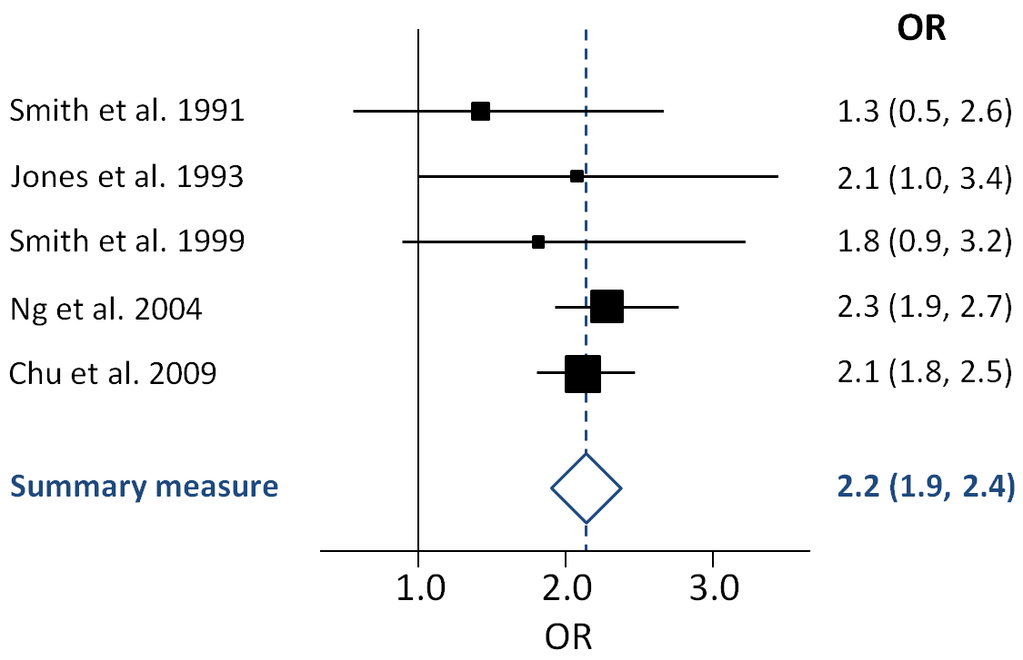
Assess – How to assess a meta-analysis
Forest plots
Notes:
Forest plots: Graphic with multiple results showing the point estimate with a bar representing the confidence interval. The point estimate is identified as a square and the size of the square is proportional to the size of the population in the study. The larger the size the more power and the more precise the results should be and the smaller your CI should be. A diamond at the bottom will represent an estimate of a collection of studies in a meta-analysis and a dashed vertical line represents the point estimate of the meta-analysis.
The comparative safety of tumor necrosis factor inhibitors in rheumatoid arthritis: a meta-analysis update of 44 trials.
Figure 4. Effect of tumor necrosis factor inhibitors versus control therapy on the occurrence of serious infections in patients with rheumatoid arthritis. CI = confidence interval; OR = odds ratio.
Am J Med. 2014 Dec;127(12):1208-32. doi: 10.1016/j.amjmed.2014.06.012. Epub 2014 Jun 17. The comparative safety of tumor necrosis factor inhibitors in rheumatoid arthritis: a meta-analysis update of 44 trials. Michaud TL1, Rho YH2, Shamliyan T3, Kuntz KM1, Choi HK4.

Slide 70
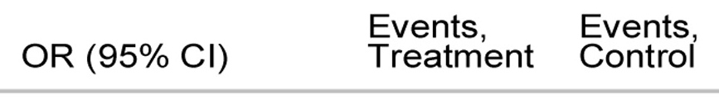
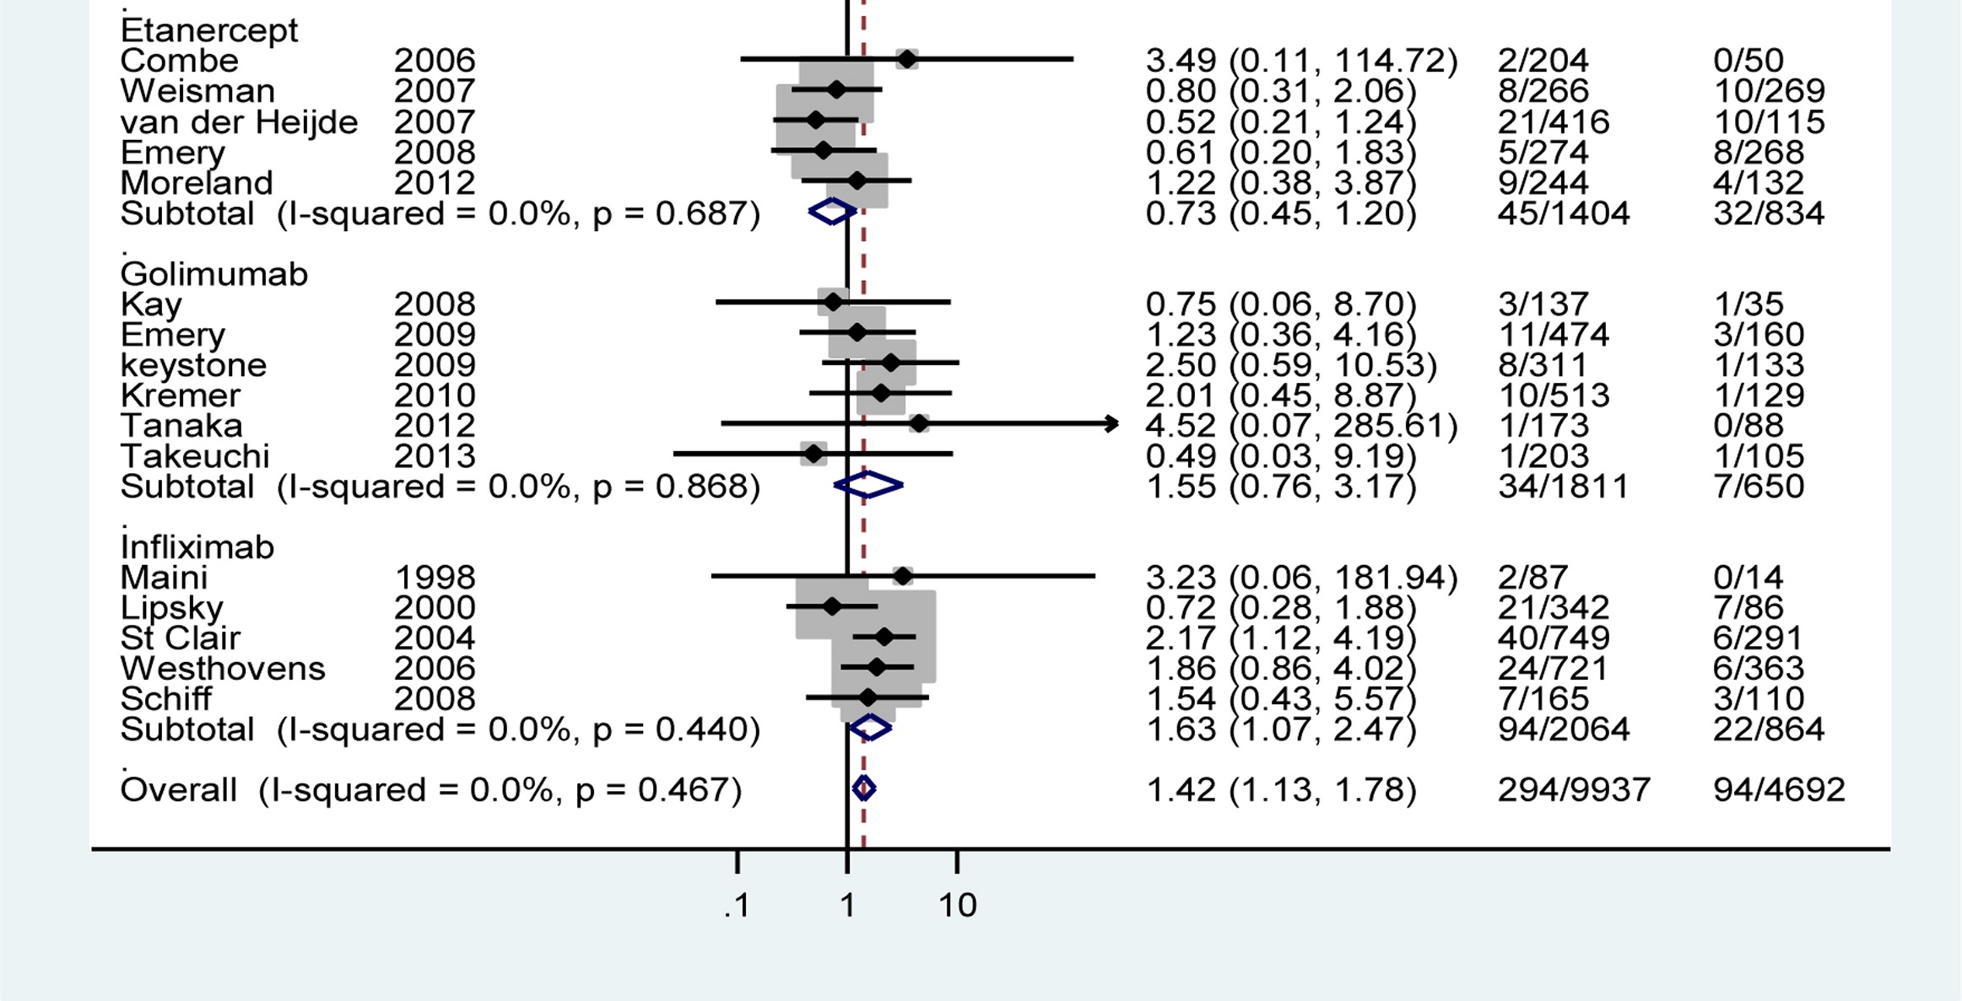
Figure 4. Effect of tumor necrosis factor inhibitors versus control therapy on the occurrence of serious infections in patients with rheumatoid arthritis.
Am J Med. 2014 Dec;127(12):1208-32. doi: 10.1016/j.amjmed.2014.06.012. Epub 2014 Jun 17. The comparative safety of tumor necrosis factor inhibitors in rheumatoid arthritis: a meta-analysis update of 44 trials. Michaud TL1, Rho YH2, Shamliyan T3, Kuntz KM1, Choi HK4.
Notes:
The comparative safety of tumor necrosis factor inhibitors in rheumatoid arthritis: a meta-analysis update of 44 trials.
Figure 4. Effect of tumor necrosis factor inhibitors versus control therapy on the occurrence of serious infections in patients with rheumatoid arthritis. CI = confidence interval; OR = odds ratio.

Slide 71
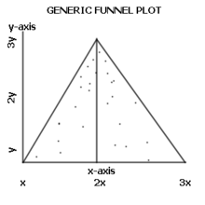
Assess – How to assess a meta-analysis
Funnel plots
https://en.wikipedia.org/wiki/Funnel_plot
Notes:
Funnel plots: This tool explores publication bias and is looked at with a meta-analysis. The idea is that small studies that show no benefit for the proposed treatment or test are not sexy and will not be chosen by journals for publication and thus the published evidence will look as though there is repeated evidence for benefit when none exists. This visual representation of published outcomes will skew toward demonstrating a generally positive effect as you move from more highly powered, and therefore more precise, studies to less highly powered studies.
Funnel plot from Wikipedia
(2 options, figure 3 or figure 5 and 4 from BMJ paper on funnel plots)
Figure 3, this figure looks at OR for an event, like the odds of having pancreatitis after ERCP if taking a new medication. There is likely publication bias up top as there is a massive skew with very low P values. And the bottom graph shows a lack of data in the bottom left of the graph where data of high significance for outcomes would be so the asymmetry is unlikely to be due to publication bias.

Slide 72
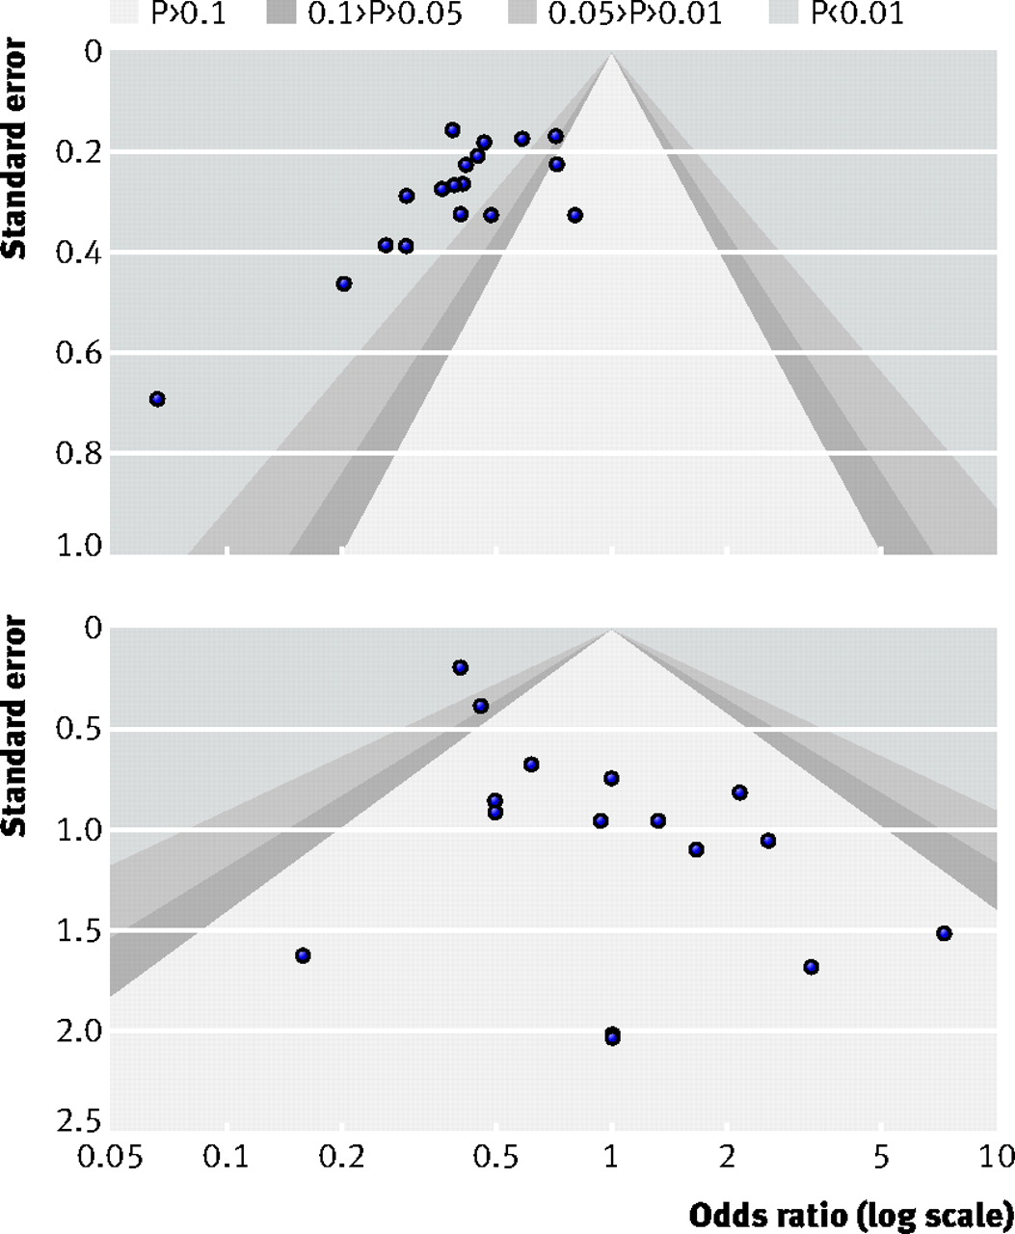
Figure 3. Figure 3, this figure looks at a funnel plot for an OR of an event, like the odds of having pancreatitis after ERCP if taking a new medication
Recommendations for examining and interpreting funnel plot asymmetry in meta-analyses of randomised controlled trials BMJ 2011; 343 doi: https://doi.org/10.1136/bmj.d4002 (Published 22 July 2011) Cite this as: BMJ 2011;343:d4002
Notes:
Figure 3, this figure looks at OR for an event, like the odds of having pancreatitis after ERCP if taking a new medication. There is likely publication bias up top as there is a massive skew with very low P values. And the bottom graph shows a lack of data in the bottom left of the graph where data of high significance for outcomes would be so the asymmetry is unlikely to be due to publication bias.

Slide 73
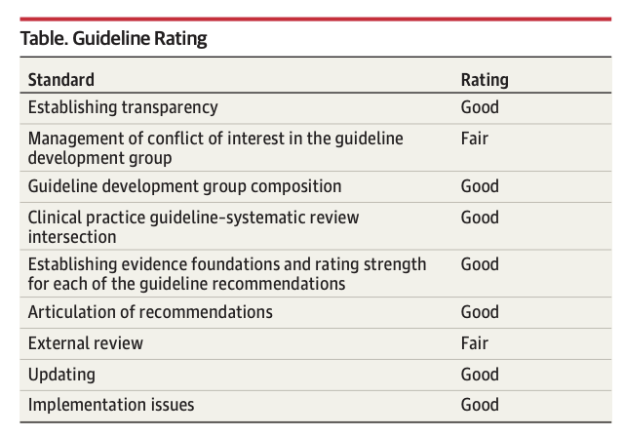
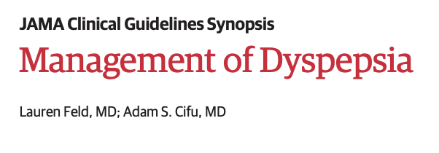
Assess – How to assess a Guideline
Notes:
This series (JAMA Clinical Guideline Synopsis) is a good reference. Also – the table gives ideas on the things to be on the look out for.
Also
JGIM – 2019 - Should evidence come with an expiration date? DOI: 10.1007/s11606-019-05032-4

Slide 74
Journal club
Practice in assessing the validity of articles, guidelines, etc.

Slide 75
APPLY

Slide 76
Apply: Roadmap
Diagnosis using Bayes
Workup guided by Bayes
Treatment using absolute measures of effect size
Shared decision making
Notes:
TODO:
[ ] add screening conundrum (e.g. breast cancer with absolute harms and benefits)
===> why don’t we just screen everyone for everything? (Say you have a rich patient ($ is no object) - what arguments can you think of against screening?
[ ] Add treatment conundrum example
[ ] Add implementation gap / science discussion

Slide 77
EBCP in action
You are called to admit the following patient: a blind 75M with cirrhosis, no prior hx of GIB, not on anticoagulation experiences painless bright red blood per rectum with clots in the stool. (clots seen by RN).
Your attending will give you an extra-day off if you can guess whether the source is upper GI or lower GI. What do you guess?
Notes:
REALLY important to get it right (for jokes, but also that this question drives your initial management).
Note: if they’ve downloaded the Diagnose app, it has this information and they can follow along (or jump ahead) – encourage learners to do this.

Slide 78
Learning objectives
Understand how and why EBM is useful to you as a trainee
Practice a structured approach to answering clinical questions
Understand Primary vs Secondary/Tertiary medical literature
Understand validity, and identify common threats to validity (Bias, Confounding, Chance)
Understand (in a non-mathy way) how Bayes Theorem can be applied to diagnosis
Understand relevant metrics to assess treatment effects.
Be able to access several useful secondary literature sources quickly, at the point of care.
@UtahIMCMRs
#EBM

Slide 79
Diagnosis – Bayes theorem
Pre-test odds (best guess) =>
New information from a test =>
Post-test odds (better guess)

Slide 80
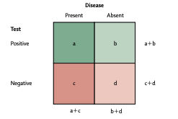
Diagnosis – Bayes theorem
Principle 1: No test is perfect
Corollary 1: having a positive test is not the same as having the disease
Notes:
This is even true of diseases that are “defined” by a lab value – this is a limitation in our case definitions, which we are using to approximate a physiology.
[ ] Could be a reasonable time to mention Receiver operating characteristic curves

Slide 81
Assess – Test Characteristics review
Sensitivity and Specificity = characteristics of a test.
High sensitivity = almost never misses someone with a disease
High specificity = almost always negative in someone without the disease.
Problem: Sens & Spec = we know the disease state, what will the test show?
Clinical practice: we know the test result, we want to know the likelihood of having the disease
Notes:
Meaning = Sens and spec we know which column, and are deciding which box. In reality, we know which row and want to figure out which box.
NPV and PPV can address this, but there’s a better way: (Bayes and Likelihood ratios).
[ ] todo Use Eccles library or JAMAevidence calculators to make sens/specificity more interactive.

Slide 82
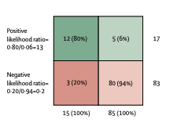
Assess - Test Characteristics review
PPV and NPV tell us what we want, but are cumbersome
Positive Likelihood Ratio =
% ill people w/ result / % healthy people with result
= Sens / (1- Spec), does NOT dependent on prevalence.
Notes:
Likelihood Ratio: Post-test odds = pre-test odds x LR
PLR: Sens / (1 – Spec). Change in the odds of disease being present with a positive test result. “The higher the PLR number, more powerful the test is at ruling in a disease.” 1 literally means that pre and post-test probability is the same. 5 is OK (30%). 10 is great. 10 increases probability of disease being present by about 45 percent.
NLR: (1 – Sens) / Spec. Change in the odds of disease being absent with a negative test result. “The smaller the NLR number, more powerful the test is at ruling out a disease.” 1 is the same. 0.5 is OK (30%). 0.1 is great. 0.1 decreases probability of disease being present by about 45 percent.
Odds;

Slide 83
Diagnosis – Bayes theorem
Pre-test odds (best guess) =>
New information from a test (LR+ or LR-)=>
Post-test odds (better guess)
Pretest Odds * LR = Posttest Odds

Slide 84
Diagnosis – Bayes theorem
Note: Odds is expressed differently than probability
Odds of heads to tails is 1:1 = 1 (”times more likely”)
Probability of heads is 50%

Slide 85
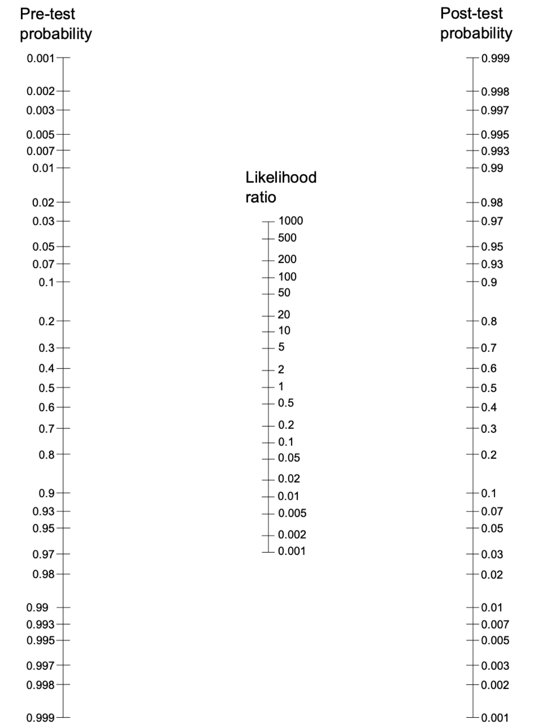
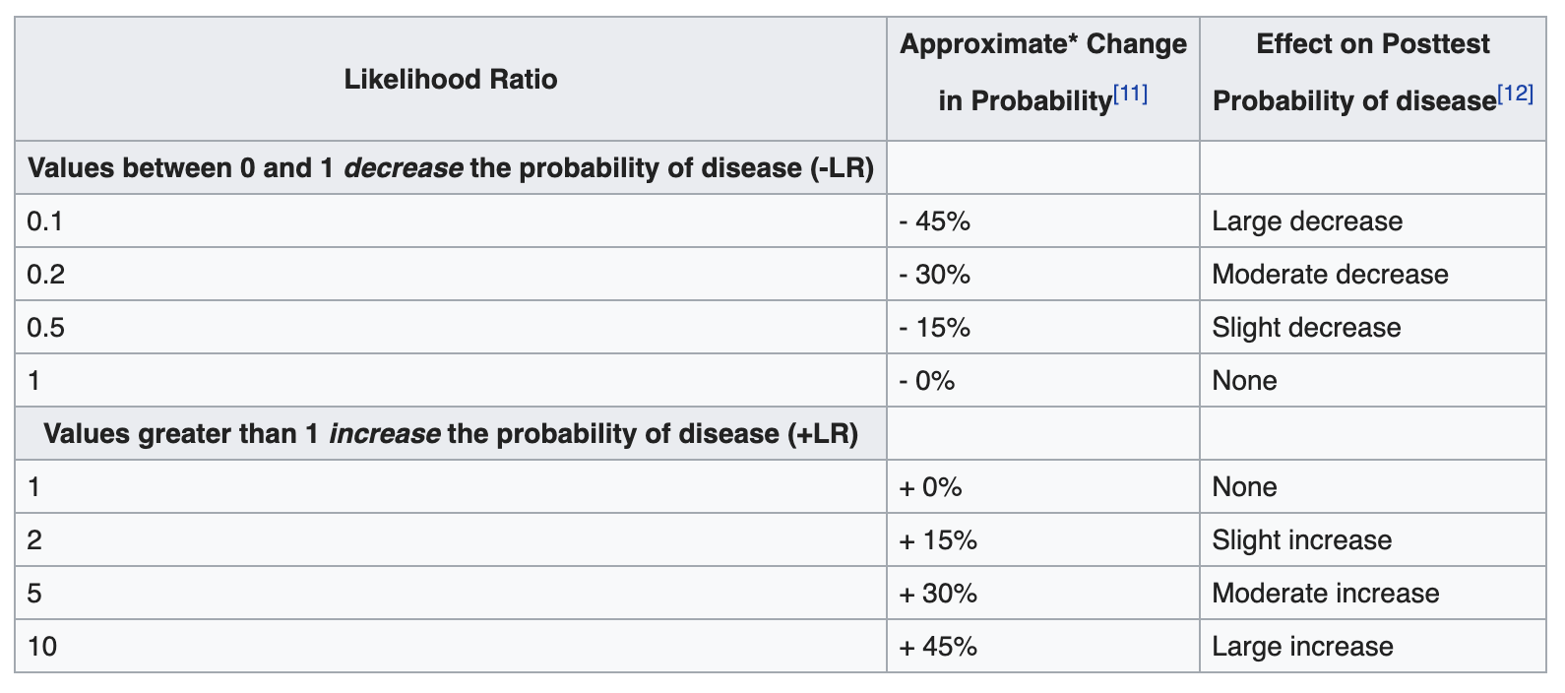
Diagnosis – Bayes theorem
If using probability:
Notes:
Fagan Nomogram = in PROBABILITY. The Math works out in ODDS (different denominator) - can use either way. We’ll do 1 example with each

Slide 86
Apply: Roadmap
Diagnosis using Bayes
Workup guided by Bayes
Treatment using absolute measures of effect size
Shared decision making

Slide 87
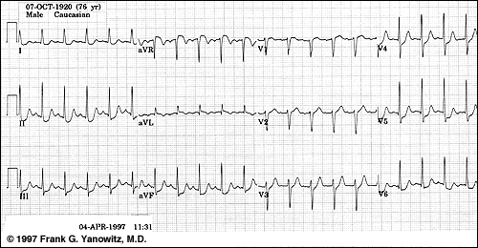

Diagnosis – Bayes theorem
Pt presents with substernal CP. I initially guess 50% chance of ACS. He gets this EKG
Notes:
Fagan Nomogram = in PROBABILITY. The Math works out in ODDS (different denominator) - can use either way. We’ll do 1 example with each
Source: Rational clinical exam (JAMA Evidence) Acute Coronary Syndrome
https://jamaevidence-mhmedical-com.ezproxy.lib.utah.edu/content.aspx?bookid=845&sectionid=129973061

Slide 88
Diagnosis – Bayes theorem
1 * 5.3 = 5.3
Pretest Odds * +LR (ST Depression) = Posttest odds
Notes:
Fagan Nomogram = in PROBABILITY. The Math works out in ODDS (different denominator) - can use either way. We’ll do 1 example with each

Slide 89
Diagnosis – Bayes theorem
What about LR close to 1?
Far from 1?
Notes:
Fagan Nomogram = in PROBABILITY. The Math works out in ODDS (different denominator) - can use either way. We’ll do 1 example with each
New formulation: LR 10+ = rules in, LR <0.1 rules out for folks that want to stay qualitiative

Slide 90


Diagnosis – Bayes theorem
Notes:
Example From BMJ Evidence Based Medicine Journal of diagnosis of HIV using clinical features and bayes reasoning. (in a HIV enedemic setting)
Shows that you can use Bayes theorem qualitatively (ie. Ignore the precise numbers) and it still improves clinical reasoning.

Slide 91
EBCP in action
You are called to admit the following patient: a blind 75M with cirrhosis, no prior hx of GIB, not on anticoagulation experiences painless bright red blood per rectum with clots in the stool. (clots seen by RN).
Your attending will give you an extra-day off if you can guess whether the source is upper GI or lower GI. What do you guess?

Slide 92

Apply – Bayes theorem
How do you determine pretest probability?
Gut feeling
Overall incidence in the population
Risk stratification rule (e.g. HEART score)
Using a cohort or trial that fits your patient
1 : 1 ratio of UGIB to LGIB.
Pretest odds = 1 (even)
Notes:
Pre-test probability: How do you determine your PreTP? You can use your gut (most do) but if your patient fits into a cohort of a trial you look up, THAT IS YOUR PreTP.
MD Calc includes risk stratification %s in each category and is $$$ for coming up with pretest probabilities, especially as an early learner
Note: Odds of 1 = Probability of 50%

Slide 93
EBCP in action
You are called to admit the following patient: a blind 75M with cirrhosis, no prior hx of GIB, not on anticoagulation experiences painless bright red blood per rectum with clots in the stool (clots seen by RN).
Your attending will give you an extra-day off if you can guess whether the source is upper GI or lower GI. What do you guess?

Slide 94


Apply – Bayes theorem
Notes:
The book is available through the library (can access remotely using ezproxy as explained in the Supporting materials

Slide 95

Apply – Bayes theorem
Pretest Probability * LR = Posttest Probability
1:1 pretest * LR(No prior history of UGIB) = Post
1 * 0.81 = 0.81

Slide 96
Apply – Bayes theorem
Pretest Probability * LR = Posttest Probability
Pre-test (after no UGIB) * LR(Age is not < 50) = Post
0.81* 0.8 = 0.648

Slide 97
Apply – Bayes theorem
Pretest Probability * LR = Posttest Probability
Pre-test (after no UGIB, age) * LR(Has Cirrhosis) = Post
0.65 * 3.1 = 2.015

Slide 98
Apply – Bayes theorem
Pretest Probability * LR = Posttest Probability
Pre-test (after no UGIB, age, cirrhosis) * LR(No hx LGIB( = post)
2.02 * 1.5 = 3.03
After hearing his demographics, I’d
give 3:1 odds in favor of UGIB
Notes:
Skipped iron use, because we don’t know (I didn’t specify one way or the other)

Slide 99


Apply – Bayes theorem
Pretest Probability * LR = Posttest Probability
Symptoms: (no epigastric pain)
3.03 * 0.9 = 2.73
Signs: (No melena exam, Clots in stool)
2.73 * 0.52 * 0.05 = 0.07
After hearing signs I’d give 1:14 odds against UGIB!
Notes:
Skipped melena hx (because we don’t know)
CLOTS = STRONG NEGATIVE LIKELIHOOD RATIO!
(Mechanistically we can rationalize this as stomach acid inhibiting clot formation…)

Slide 100
Apply: Roadmap
Diagnosis using Bayes
Workup guided by Bayes
Treatment using absolute measures of effect size
Shared decision making

Slide 101
EBCP in action
You’re in the ED, considering PE on a 49F with: SOB and chest pain, no leg swelling or pain, HR 90, no recent immobilization, no hx clots, no hemoptysis, no cancer. Room air SpO2 96%. Not on birth control or HRT.
Next Step?
Notes:
Let them know to use any resources (eg. MD Calc

Slide 102

Apply –
Pulse.Utah.edu Suspected PE pathway
Notes:
Why PERC Negative = no further testing?
Why high risk by simplified wells = straight to PE?

Slide 103

Apply – Testing Threshold, Treatment Threshold
Notes:
So far to the left that it’s not worth testing. = we are BELOW the testing threshold for DDimer
Diagnosis is usually not a binary decision (ie, true of false) turning on a single datum, but a dynamic probabilistic assessment.
Further testing outside the middle will only lead to confusion (probably false positives and negatives)
Using the probability of diagnosis line, pretest probability, posttest probability, diagnostic testing threshold, and treatment thresholds explain how a physician considers a diagnosis and what they should do about it (figure 10-2). What causes these thresholds to move up or down? (the safer and cheaper the test or Tx, down; the worse the result of the disease, down; if you would do nothing about the diagnosis, way up) LRs don’t help if your PreTP is close to 1 or 0 on this line. They only help stratify when the diagnosis is possible but uncertain.
What causes these thresholds to move up or down? (the safer and cheaper the test or Tx, down; the worse the result of the disease, down; if you would do nothing about the diagnosis, way up). A better test = wider range between the thresholds.
LRs don’t help if your PreTP is close to 1 or 0 on this line. They only help stratify when the diagnosis is possible but uncertain.

Slide 104
Apply – PE Diagnosis
PERC negative =
PE pretest prob ~ <1%
D-Dimer = LR+ 2, LR- 0.15
Even if DDimer+, still only <2%
posttest probability
Notes:
Why PERC Negative = no further testing? Even positive ddimer isn’t going to make me get a CT
2% is the most common acceptable miss rate in the ED – though, it begs the question of how bad it would be to miss a PE? Is this the same in call cases? Thus, should the algorithm change depending on the circumstance?
PERC negative is probably WAY under 2% (that was just the limitation based on the size of study.
Why high risk by simplified wells = straight to PE?

Slide 105
EBCP in action
You’re in the ED, considering PE on a 55F with: SOB, scant hemoptysis, breast cancer on chemo, HR 105, no recent immobilization or surgery, no hx clots, no swelling or pain in legs
Next Step?

Slide 106
Apply – PE Diagnosis
Highest Risk Wells =
PE pretest prob ~ 40%
D-Dimer = LR+ 2, LR- 0.15
Even if Ddimer-, still 10%
posttest probability
Notes:
Why high risk by simplified wells = straight to CT Pulmonary Angiogram? Still a 10% chance of PE even with a negative DDimer

Slide 107
EBCP in action
You’re in the ED, considering PE on a 55F with: known brittle asthma, SOB, no leg swelling, HR 105, cholecystectomy 3 weeks ago, no hx clots, no hemoptysis, no cancer.
Next Step?
Notes:
Download MD Calc app

Slide 108
Apply – PE Diagnosis
Moderate Risk Wells =
PE pretest prob ~ 16%
D-Dimer = LR+ 2, LR- 0.15
If Ddimer-, 2% posttest
probability (acceptable)
Notes:
Why PERC Negative = no further testing?
Why high risk by simplified wells = straight to PE? Still a 10% chance of PE even with a negative DDimer
2% is the miss rate that is acceptable in the ED.

Slide 109
Bayes theorem Summary
Pre-test odds (best guess) =>
New information from a test =>
Post-test odds (better guess)

Slide 110

PE Diagnosis with Bayes
Take Home: DDimer only changes management in Wells 0-4
Fagan’s Nomogram
Above testing threshold regardless of result = won’t change management
PERC Negative = 1.4%
Diagnostic Threshold: Higher => no further testing. Diagnostic certainty sufficient to treat
Wells 0-4 = 12.1%
(exact diagnostic threshold depends on how bad consequences of incorrectly treating are)
= Positive DDimer
+LR 1.68
Wells 4+ = 37.1%
Not confirmed or excluded, need further testing:
CTPA (or V/Q)
Pre-test probability based on Two-tier Wells & PERC Score. (or cohort… or gestalt)
= Negative DDimer
-LR 0.13
(exact testing threshold depends on how bad consequences of missing diagnosis are)
Testing Threshold: Lower => no further testing, diagnosis excluded
Below testing threshold regardless of result = won’t change management
Ann Intern Med. 2004;140:589-602. DOI: 10.7326/0003-4819-140-8-200404200-00005
JAMA. 2006;295(2):172-179. doi:10.1001/jama.295.2.172
J Thromb Haemost. 2004 Aug;2(8):1247-55. DOI: 10.1111/j.1538-7836.2004.00790.x

Slide 111
Apply: Roadmap
Diagnosis using Bayes
Workup guided by Bayes
Treatment using absolute measures of effect size
Shared decision making

Slide 112
EBCP in action
You’re in clinic. 59M with no hx of CAD, LDL 100, hsCRP 2.4 wonders if he should take a statin?
Notes:
Download ASCVD calc app
PICO:
Patient: 59, healthy, no hx
Intervention: statin tx
Comparison: no statin
Outcome: mortality

Slide 113
Apply – Statin for Primary prevention of CAD
Notes:
Aka we have to figure it out ourselves.

Slide 114


Apply – Treatment effects
Notes:
RR often reported as it is most relevant to explaining if the mechanism of an intervention works, and if so how strongly it might work (because RR is somewhat independent of the underlying risk of the population)

Slide 115
Learning objectives
Understand how and why EBM is useful to you as a trainee
Practice a structured approach to answering clinical questions
Understand Primary vs Secondary/Tertiary medical literature
Understand validity, and identify common threats to validity (Bias, Confounding, Chance)
Understand (in a non-mathy way) how Bayes Theorem can be applied to diagnosis
Understand relevant metrics to assess treatment effects.
Be able to access several useful secondary literature sources quickly, at the point of care.
@UtahIMCMRs
#EBM

Slide 116
Apply – Treatment effects
RR: Relative Risk
RRR: Relative Risk Reduction
ARR: Absolute Risk Reduction
NNT: Number needed to treat (1/ARR)
Notes:
RR often reported as it is most relevant to explaining if the mechanism of an intervention works, and if so how strongly it might work (because RR is somewhat independent of the underlying risk of the population)
Example:
EER (Experimental Event Rate) = .001 “The risk of developing melanoma over 20 years in the (sunscreen) experimental group was 0.1% or 1 in 1000.” “The proportion of those who developed melanoma over 20 years in the sunscreen group was 1 out of 1000.” “The rate of developing melanoma in the sunscreen group was 0.1%”
CER (Control Event Rate) = .005 “The risk of developing melanoma over 20 years with placebo is 0.5%.”
ARR (Absolute Risk Reduction) = EER-CER = .004 “Sunscreen use reduces the absolute risk of developing melanoma by 0.4%.” “0.4% of patients, or 4 of 1000, are preventing from developing melanoma by using sunscreen.” “For every 1000 patients using sunscreen, 4 cases of melanoma are averted.”
NNT (Number-needed-to-treat) = 1/ARR = 250 “250 patients would need to be treated with sunscreen rather than placebo for 20 years to prevent one additional case of melanoma.”
RR (Relative Risk) = EER/CER = .20 “People who use sunscreens for 20 years have less than a fifth of the risk of developing melanoma of those who use a placebo. Alternatively, people who do not use sunscreens have a 5 times greater risk of developing melanoma over 20 years as compared to those who use sunscreens.” “The risk of melanoma without sunscreen is 5 times the risk with sunscreen.” “The rate of melanoma with sunscreen is 20% of the rate without sunscreen.” Risk remaining: “Just 20% of the original risk of developing melanoma remains for those who use sunscreen.”
RRR (Relative Risk Reduction) = (EER-CER)/CER or 1 – RR = .80 “Sunscreen use decreases the risk of developing melanoma by 80% compared with no sunscreen.” Risk removed: “80% of the risk of developing melanoma is removed by using sunscreen.”

Slide 117

Apply – Treatment effects
Notes:
For primary end point:

Slide 118
Apply – Treatment effects
Mortality:
RR: Relative Risk (~Hazard Ratio): 0.56
RRR: Relative Risk Reduction: 0.44 (or 44%)
ARR: Absolute Risk Reduction:
1.36 – 0.77 = 0.59 per 100 person years
NNT: Number needed to treat (1/ARR)
Treat for 170 years to avoid 1 event (ACS, stroke, stent, or death)
Notes:
Note: Hazard Ratio, Odds Ratio, Relative Risk are not technically the same, but take the same role. Difference is in how the
NNT to treat is often most helpful in quantifying the strength of a treatment effect.
Clinicians' views of drug therapies are affected by the common use of relative risk reductions in both trial reports and advertisements, by end-point emphasis, and, above all, by underuse of summary measures that relate treatment burden to therapeutic yields in a clinically relevant manner.
Ann Intern Med. 1992 Dec 1;117(11):916-21. Measured enthusiasm: does the method of reporting trial results alter perceptions of therapeutic effectiveness? Naylor CD1, Chen E, Strauss B.
44% relative risk reduction in primary end-point: composite of myocardial infarction, stroke, arterial revascularization, hospitalization for unstable angina, or death from cardiovascular causes.
1.36 – 0.77 = 0.59 per 100 person years absolute risk reduction.
1/ARR = NTT = 170 years of treatment to avoid 1 event.

Slide 119
Apply – Treatment effects
Notes:
For death:
1.25 – 1.00 = 0.25 per 100 years (ARR)
400 years of treatment to prevent 1 death.

Slide 120
Apply – Treatment effects
Mortality:
RR: Relative Risk: 0.8
RRR: Relative Risk Reduction: 0.2 (or 20%)
ARR: Absolute Risk Reduction:
1.25 – 1.00 = 0.25 per 100 person years
NNT: Number needed to treat (1/ARR)
Treat for 400 years to avoid 1 event (death)
Notes:
NNT to treat is often most helpful in quantifying the strength of a treatment effect.
Clinicians' views of drug therapies are affected by the common use of relative risk reductions in both trial reports and advertisements, by end-point emphasis, and, above all, by underuse of summary measures that relate treatment burden to therapeutic yields in a clinically relevant manner.
Ann Intern Med. 1992 Dec 1;117(11):916-21. Measured enthusiasm: does the method of reporting trial results alter perceptions of therapeutic effectiveness? Naylor CD1, Chen E, Strauss B.

Slide 121
Apply: Roadmap
Diagnosis using Bayes
Workup guided by Bayes
Treatment using absolute measures of effect size
Shared decision making

Slide 122
Apply – Shared decision making
Outline particular values, as well as risks, benefits, and consequences of different decisions (JAMA 2019)
Notes:
NNT to treat is often most helpful in quantifying the strength of a treatment effect.
Clinicians' views of drug therapies are affected by the common use of relative risk reductions in both trial reports and advertisements, by end-point emphasis, and, above all, by underuse of summary measures that relate treatment burden to therapeutic yields in a clinically relevant manner.
Ann Intern Med. 1992 Dec 1;117(11):916-21. Measured enthusiasm: does the method of reporting trial results alter perceptions of therapeutic effectiveness? Naylor CD1, Chen E, Strauss B.
“Calls for SDM in guidelines and recommendations alone, which appear to be becoming more common, are insufficient. To bemeaningful, a specific recommendation for SDM should clearly outline the particular values, as well as the risks, benefits, and consequences, of different decisions for patients”

Slide 123


Apply – Decision Aids
Low dose CT Lung Cancer Screening: https://effectivehealthcare.ahrq.gov/decision-aids/lung-cancer-screening/home.html
Notes:
One systematic review found that the use of decision aids nearly always improved the quality of SDM, with the authors concluding that “it seems unrealistic to ask healthcare providers to bear the responsibility of involving their patients in health-care decisions single-handed—the patients themselves and communication tools are also a big part of the solution.” doi: 10.1111/hex.12054
Mention Ecological Fallacy: ”ecological fallacy (or ecological inference fallacy)^{[1]} is a formal fallacy in the interpretation of statistical data that occurs when inferences about the nature of individuals are deduced from inferences about the group to which those individuals belong.” - Wikipedia
Stated another way – we can make the right decisions (play the odds), but we don’t know what will happen to each individual patient in each case – there is inherent uncertainty, even if we make statistically optimal decisions. Thus, it’s important to weigh individual’s preferences for or against possible outcomes, even when the “expected value” of a decision is positive (on average)

Slide 124
Learning objectives
Understand how and why EBM is useful to you as a trainee
Practice a structured approach to answering clinical questions
Understand Primary vs Secondary/Tertiary medical literature
Understand validity, and identify common threats to validity (Bias, Confounding, Chance)
Understand (in a non-mathy way) how Bayes Theorem can be applied to diagnosis
Understand relevant metrics to assess treatment effects.
Be able to access several useful secondary literature sources quickly, at the point of care.
Notes:
[ ] todo: I think adding an implementation science introduction to the end could be a useful way to close

Slide 125


